Slide 1
LEAP Online: Badgetastic and Beyond!
Dawn Grundy & Graeme Prescott
d.grundy@bolton.ac.uk
g.prescott@bolton.ac.uk
@HHSUofBLib
@GraemePrescott
Notes:
Dawn intro

Slide 2
LEAP Online
Academic skills portal
Library led project – university wide
Notes:
Based on LDF written by library & student experience dept. Includes contributions form Careers, SU, Student Experience and interested Academics.
Expanded version of our old study skills portal – BISSTO.

Slide 3
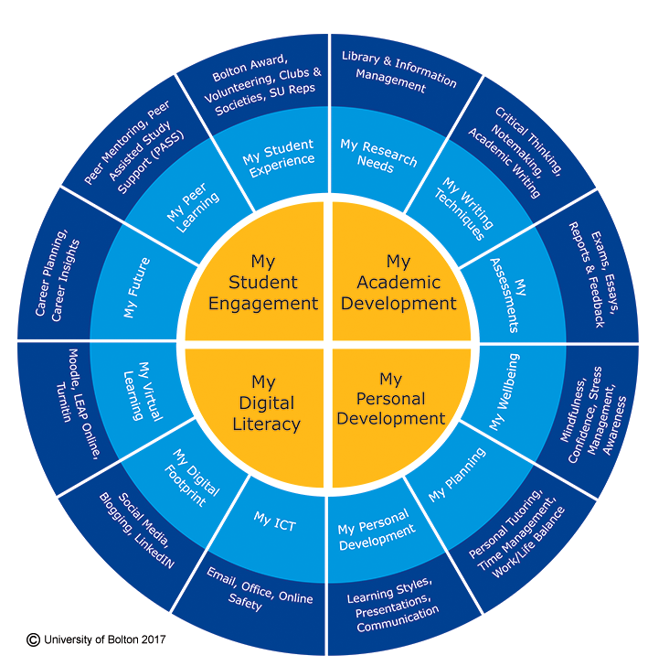
Notes:
Explanation of four sections

Slide 4
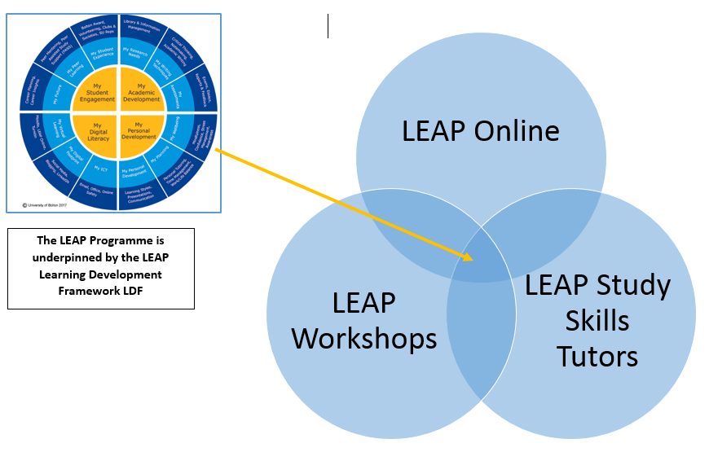
LEAP Programme
L Learning
E Excellence
A Achievement
P Pathway
Notes:
LEAP Online is the online version of the LDF – face to face activities also take place, done by other departments.

Slide 5
LEAP Online
BISSTO re-developed to support the LDF
Present in dynamic engaging way
Badged assessments
First phase launched: September 2017
Further developments – continuous improvements.
http://www.bolton.ac.uk/leaponline/Home.aspx
Notes:
Based on feedback from students – less text.

Slide 6
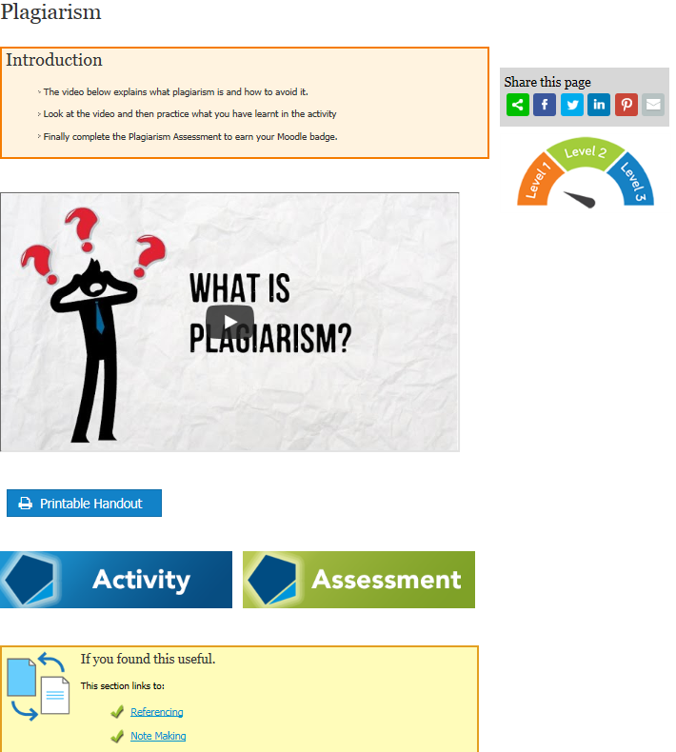
Notes:
LO learning content openly accessible under Creative Commons licence.
LO integrated with Moodle, to deliver badged assessments (UoB students only)
Typical page layout
Introduction
PowToon (animation)
Printable handout (of PowToon)
Activity – on the majority of sections
Assessment – on all sections
Links to other related content
LEAP Levels (L1, L2, L3)
Levels colour coded and visually signposted (LEAP level graphic)
Levels increase in complexity and depth of learning required
Level of learning and skill acquisition mapped to HE levels (L1 HE4/Foundation, L2 HE5, L3 HE6)
PowToon
High impact tool for delivery of information
Students engage better with information than with text heavy web pages
Articulate Storyline
Industry standard content authoring tool
Mobile compliant
Interactive – drag and drop etc.
Rapid authoring and development workflow

Slide 7
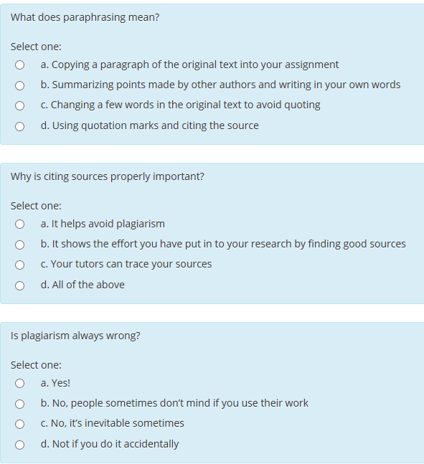
Notes:
Typically Moodle badged assessment.

Slide 8
Notes:
Example badge design.

Slide 9
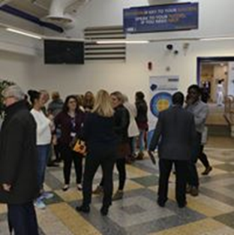
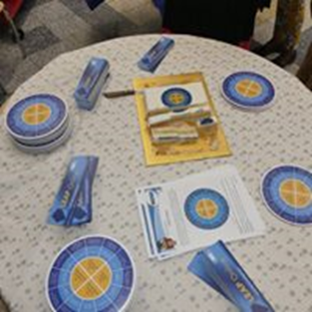
Launch & Promotion
Workshop at UoB TIRI July 2017
Launch event September 2017
Merchandise
Staff launch:
mouse mats
bookmarks
cake!
Students Welcome packs:
wall planner
drinks coaster
Library:
banner
bookmarks
Notes:
Collaboration between Library and student experience – welcome packs
Library inductions.
Training for library staff.

Slide 10
Advocacy
Academic endorsement was key!
Embedded in curriculum –
directed completion as part of skills module classes
referrals via student Action Learning Plans.
Requests for specific content, e.g. Referencing trouble shooting.
Student Experience – continuous dialogue and promotion
Interest from OCD, different models of franchise give us new challenges
Notes:
Schools with high academic engagement have high student engagement
SE – promoting LO is discussions with staff about student engagement and personal tutoring. Especially with academic responsible for quality who disseminate to the rest of academic teams.
OCD – some programmes don’t have online access and therefore don’t use Moodle.

Slide 11
Engagement
Badge data is used as the main indicator
Grammar and Referencing most popular badges.
Centre for Nursing high users.
Dissemination – badge data & new content Social Media
Monthly University newsletter
School meetings
Monthly data - HOS reports to University senior managers
1st month – 37 badges available
697 badges earned
230 students
June 2018 – 59 badges available
3666 badges earned
672 students
Notes:
Publicised programme & school with most badges – ensured some competition. Some academic requested the data fro their programme to check engagement & encourage competition.
Requests from students for a list of badges available.
Senior university managers want to see impact
Anecdotally – in person email. and formally through meetings such as SSLC’s and Board of Study.

Slide 12
Feedback Journey
Good feedback from staff – anecdotal & formal
Capturing more feedback
Student survey - January 2018
all students who had earned a digital badge
good level of response
results to be analysed
Staff survey planned
Some direct student feedback & engagement via twitter
Notes:
Anecdotal – in person & by email, both academics and professional staff involved in skills provision
Academic staff report student response to it – ie, they like , they like the badges, find it useful, they want more!
Formal – programme and school meetings – minuted how useful it is.
Student survey – about 380 students, excluded 3rd years.
Survey showed very positive responses, useful evidence towards our LILAC award. Demonstrates impact.

Slide 13
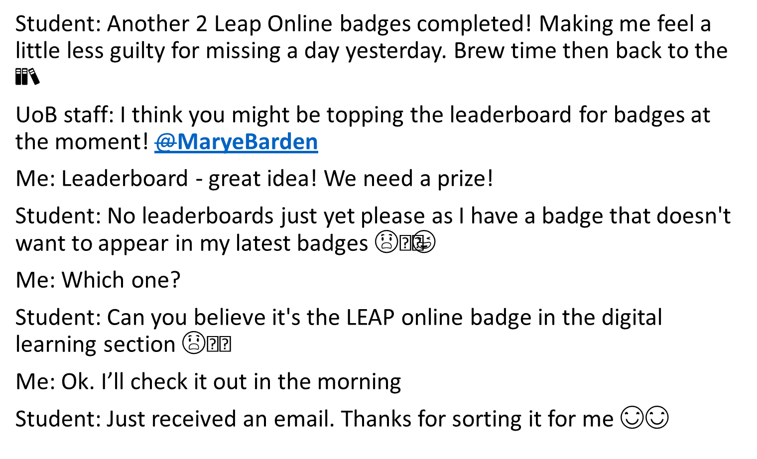
Student tweet:

Slide 14
Promotion & Development Plans
Promotional video - students & staff ‘champions’
https://www.youtube.com/watch?v=WBUn8yuxnkI
Reflect & analyse
Demonstrate value and impact
UoB conference – showcase best practice
Future content
Further levels
OCD – specific content
HE6+ content
New interface - WordPress
Notes:
Video is designed to promote LO with evidence and endorsement from it’s users.
We need to reflect and analyse and really showcase best practice across university – demonstrate impact to senior managers and encourage wider uptake across schools.
Content – feedback for more challenging content
New interface – mobile device friendly. Activities more accessible – working with a visually impaired student to improve accessibility

Slide 15
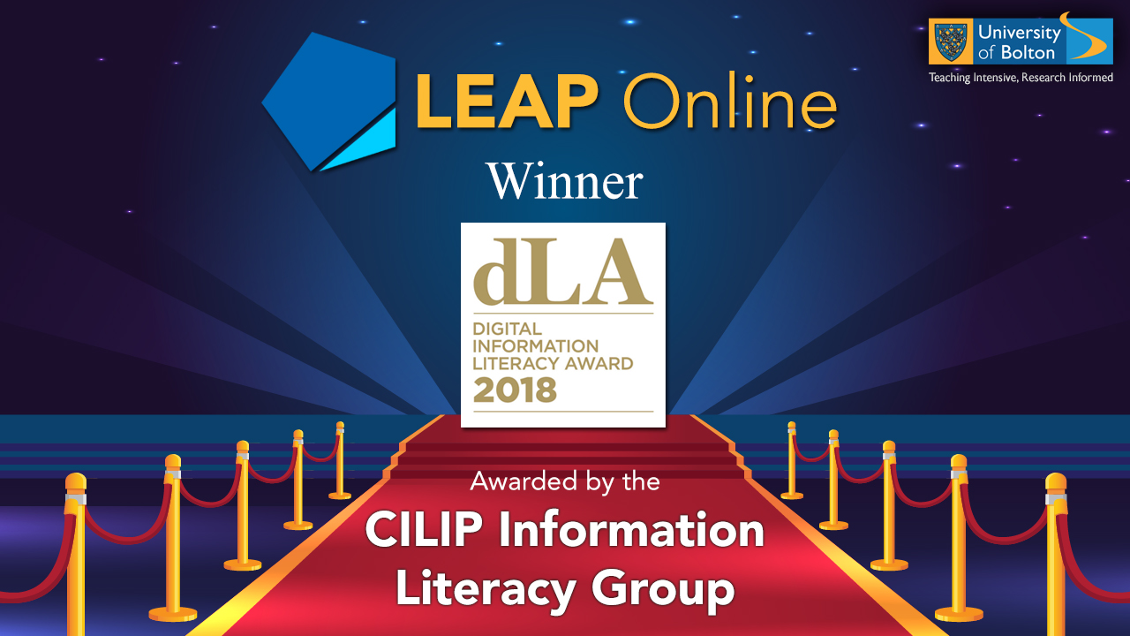
Celebrate Our Success
LILAC Winners 2018
Notes:
LILAC Winners 2018
Greater recognition within UoB
Increased collaboration – staff/students/LEAP team
Greater recognition among learning developers/information literacy professionals in the wider community (LDHEN, JISC, ALT)
Presenting LO at University of Lancaster – Enhancing Learning & Teaching in Management Education (Teach Meet)
Invited to write for London Met #Take 5 Blog – LO development and implementation
Journal article – The LEAP Framework: A Model for Student Learning Development in HE
ALT application – Learning Technologist of the Year (Team)

Slide 16
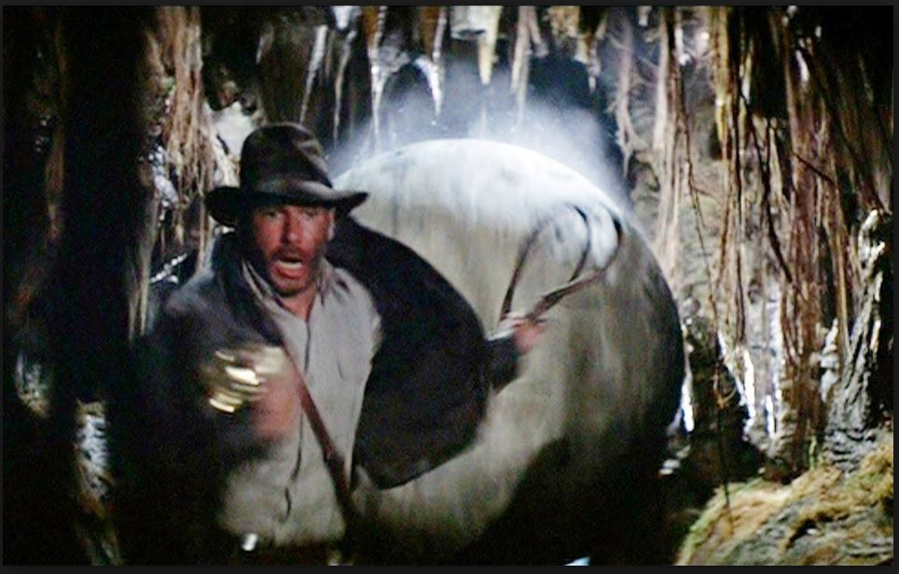
Notes:
How do feel about LO – exciting, impact on student, great feedback, well known in uni – but… it can be overwhelming, we need to keep moving or it will squash us flat!

Slide 17
Questions?

