Slide 1
Supporting Priority Setting Partnerships
Steve Glover, Head of Library Services
Olivia Schaff, Clinical Outreach Librarian
Clinical Librarians Meeting 2017

Slide 2
Since 2014 the CMFT Library has been involved in four PSPs
Stillbirth
Womb Cancer
Patient Safety in Primary Care
Endometriosis

Slide 3
701 searches @ £28.66p per question

Slide 4
benefits of collaborating on PSPs
Increased subject knowledge around stillbirth, womb cancer, primary care safety, & endometriosis
Raised profile for the library service within Trusts, NIHR, University of Manchester
Generated income for the library
Income re-invested in subject specific resources

Slide 5
benefits of collaborating on PSPs
Contributed towards MAHSC objectives
Work with University and NIHR Biomedical Research Centre on systematic reviews
Publication in High Impact Journals, named authors and / or acknowledgements

Slide 6
How did the library get involved?
Autumn 2014: approached by Dr Alex Heazell, Senior Lecturer (Univ of Man) & Honorary Consultant at St Mary’s Hospital (CMFT)
Needed support for a Priority Setting Partnership (PSP) by conducting literature searches
We had a short timescale as the PSP was already well along the project plan
Agreed an hourly rate for carrying out the searches
Contracted additional librarians to help deliver capacity
This experience informed our approach to the Womb Cancer PSP

Slide 7
What is a Priority Setting Partnership (PSP)?
A PSP brings together stakeholders and the public and aims to identify the top research priorities in a particular area, such as Stillbirth
The National Institute for Health Research (NIHR) through the James Lind Alliance (JLA) is coordinating a series of PSPs to help prioritise funding
Clinicians, researchers, funding agencies, professional bodies, patient groups, parents, & charities

Slide 8
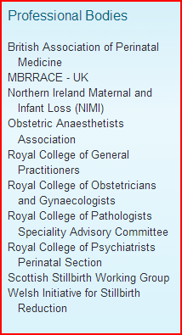

Slide 9
JLA helps coordinate the PSP and is coordinated by the NIHR
JLA methodology empowers patients and carers in the identification of research priorities
Aims to seek out treatment uncertainties
Uncertainties are treatments that have no up-to-date reliable systematic reviews or evidence

Slide 10
JLA PSP Methodology
Convene a Steering Group
Identify partners and stakeholders
Identify & gather uncertainties via a survey
Check uncertainties
Refine list of uncertainties
Interim prioritisation via second survey
Priority setting workshop
Set research priorities
Publish priorities & investigate research funding

Slide 11
Questions already grouped into general topic areas
Split topics amongst search group
Created search string to share
PSP Search strategy MeSH
Endometriosis Keywords (truncated where appropriate)
Endometrio*
(Endometrioma, Endometriomas, Endometrioses, Endometriosis, Endometriotic, Endometrioid)
Endometrium*
Endometrial*

Slide 12
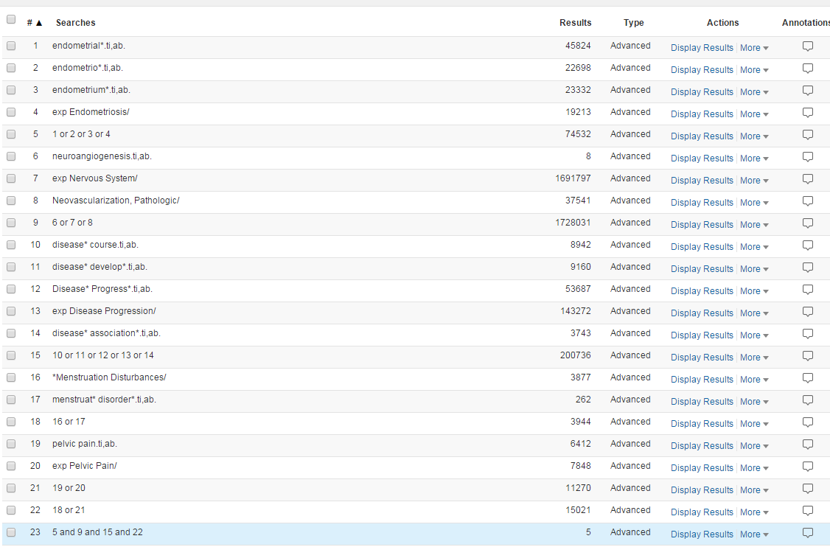

Slide 13
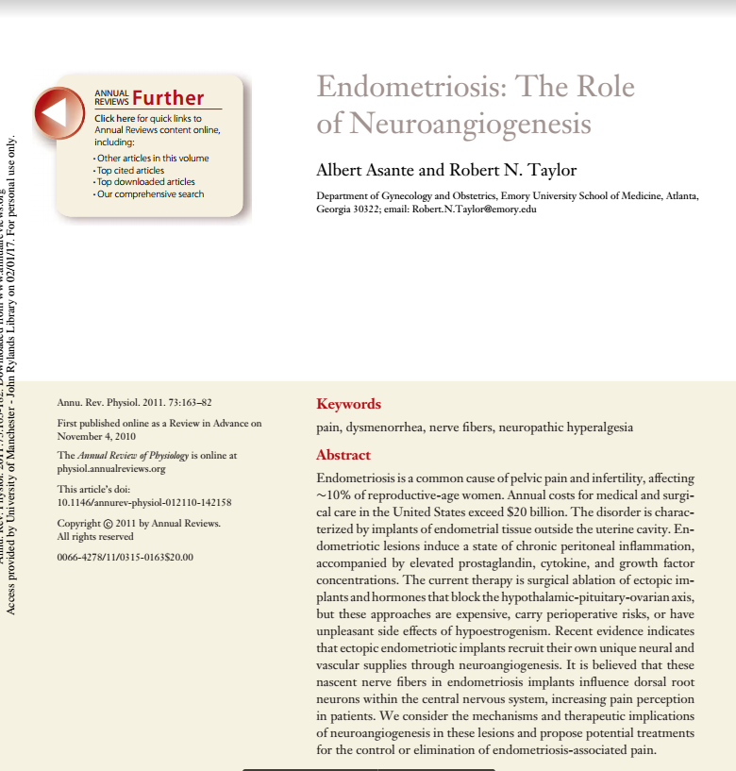

Slide 14
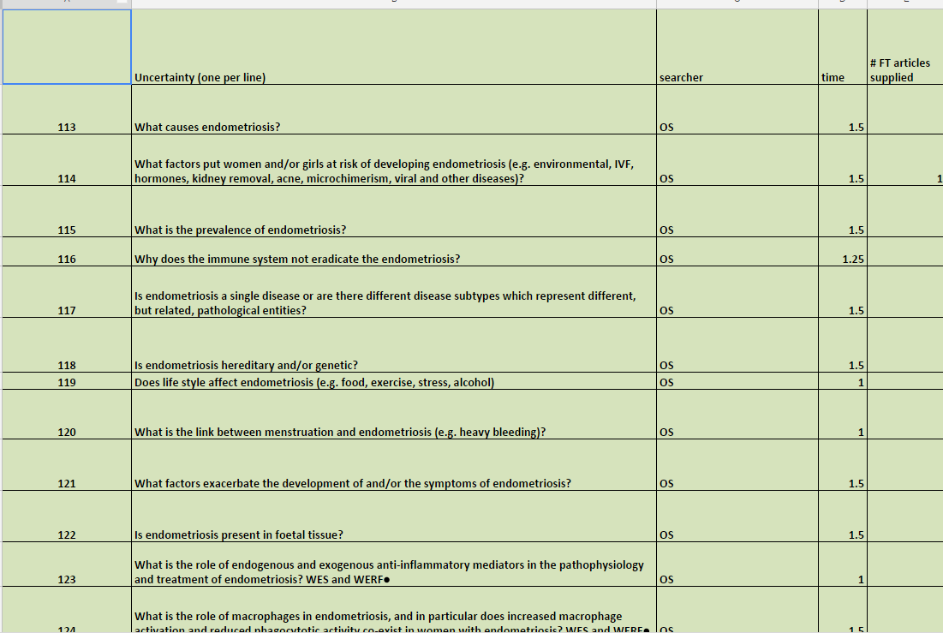
Keeping track
Cinahl, Medline, Embase, Cochrane, PsycINFO

Slide 15
Sharing results
Notes:
Add in image of WCA screen

Slide 16
Challenges of looking for uncertainties
Reverse psychology
As Clinical Librarians its in our DNA to want to find articles that meet the search criteria
When to stop on a question
“do a quick google scholar / PubMed search”
You have to take a systematic approach for all questions

Slide 17
So what is a “hit” or a yes?

Slide 18
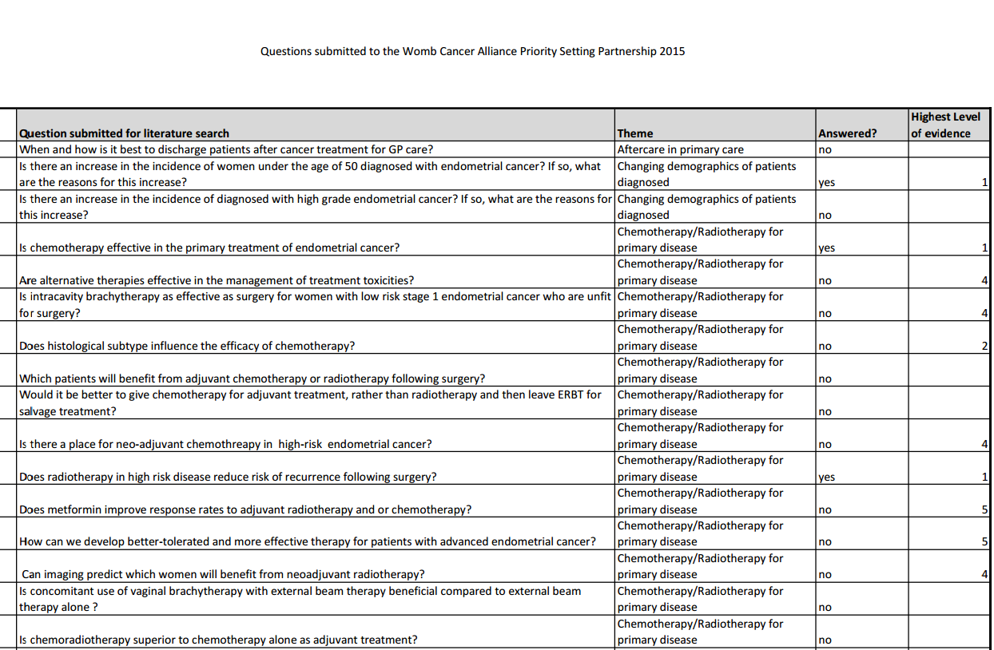

Slide 19
So what Is a “hit” or a yes?
Level 1 Evidence such as an up to date Cochrane Review, NICE Guidelines, Comprehensive Systematic Review that concludes a definitive answer
All other levels of evidence are considered an uncertainty including Cochrane Reviews which conclude that the results are uncertain.

Slide 20
Final priority setting
Results brought forward from the second survey
Stakeholder groups ranked the questions
Repeated twice
Final whole group discussion
Research priorities set
Publication & dissemination

Slide 21
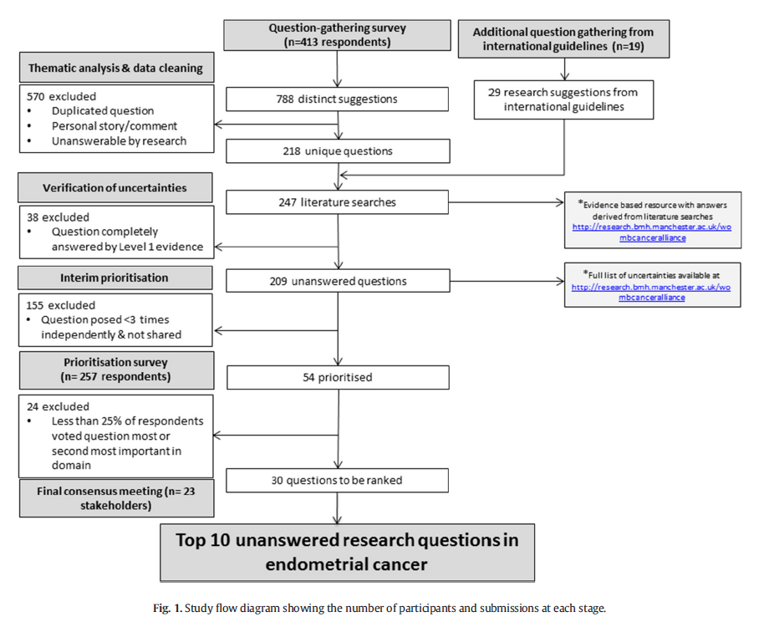

Slide 23
Authorship & Acknowledgements
Agree costings for searches
Lead person get authorship
Collaborators & library staff get acknowledgements

Slide 24
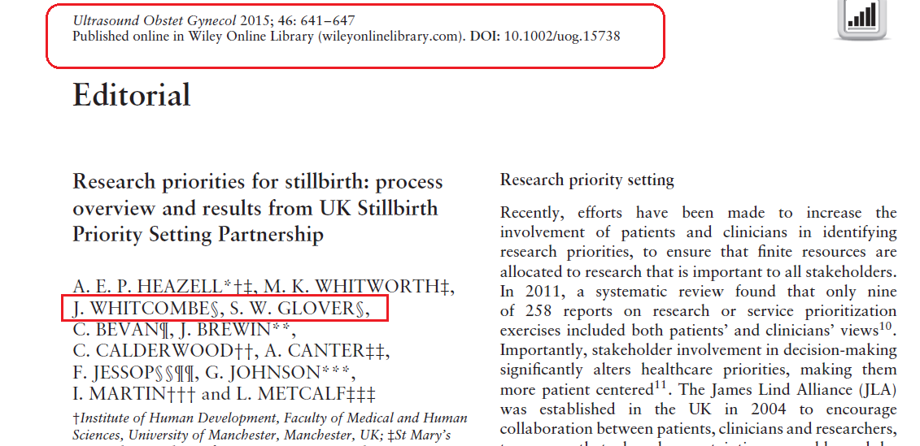

Slide 25
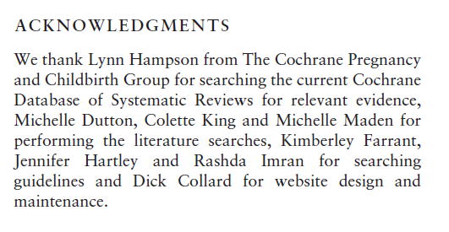

Slide 26
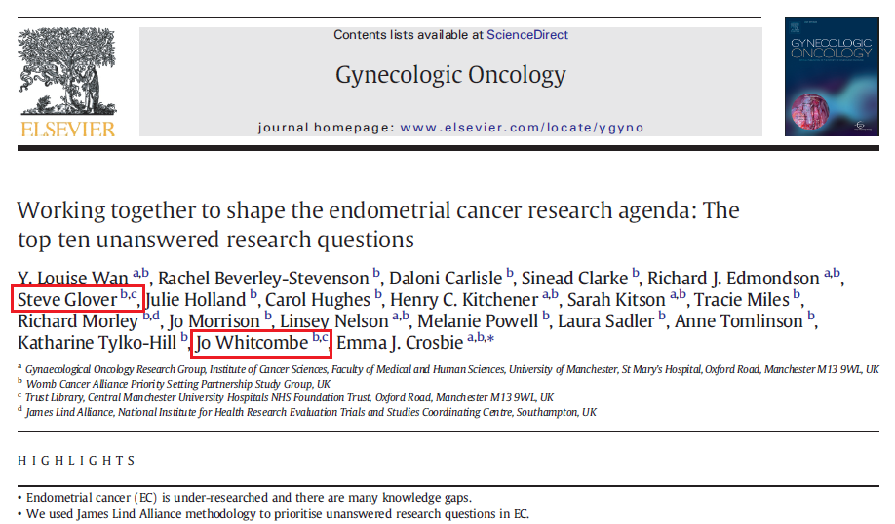

Slide 27
