Slide 1

Knowledge for Healthcare
Becoming Business Critical….
Making it happen
David Stewart
Regional Director of Health Library & Knowledge Services North
16 May 2019
Notes:
This is a pick and mix slide deck
Welcome.
This slide set introduces the challenges faced by the NHS and the opportunities for library and knowledge services, in the context of the first phase of Knowledge for Healthcare and moving into the next iteration of the strategic framework.
It includes recent highlights from each of the current work streams. The work streams may change slightly in the context of reviewing the strategic framework.
All of the elements in Knowledge for Healthcare aim to ensure that library and knowledge specialists are business critical to the NHS.
[Note: at the end of the slide set we have links to some of the key resources produced through Knowledge for Healthcare]

Slide 2
Our Vision
NHS bodies, their staff, learners, patients and the public use the right knowledge and evidence, at the right time, in the right place, enabling high quality decision-making, learning, research and innovation to achieve excellent healthcare and health improvement.”
First 5 years of 15 year framework
Reframing the role of librarians and knowledge specialists
https://www.hee.nhs.uk/our-work/library-knowledge-services
Notes:
Knowledge for Healthcare was always a 15 year strategy, with a framework for the first 5 years.
In those first five years, we have re-framed the role of library and knowledge services positioning librarians and knowledge specialists as key to enabling evidence-based decision making and mobilising knowledge to underpin improvements in patient care and safety, experience and outcomes and encouraging the spread of innovation

Slide 3

Knowledge for Healthcare
First 5 years of 15 year framework
Reframed delivery of evidence to NHS
Basis for moving towards equitable service
https://www.hee.nhs.uk/our-work/library-knowledge-services
Notes:
Knowledge for Healthcare was always a 15 year strategy, with a framework for the first 5 years.
In those first five years, we have re-framed the role of library and knowledge services as key to an evidence-based NHS.

Slide 4

Becoming business critical
Healthcare library and knowledge services are a powerhouse for education, lifelong learning, research and evidence-based practice.
Our ambition is to extend this role so that healthcare knowledge services become business-critical instruments of informed decision making and innovation.”
Professor Ian Cumming, OBE,
Chief Executive HEE
Notes:
[Patrick]
Securing health and high quality care now and for future generations will depend upon use of evidence, spread and adoption of good practice and sharing knowledge - this is why our role is business critical.
In introducing Knowledge for Healthcare, HEE’s CEO emphasized the role of library and knowledge services and the ambition to extend this role.

Slide 5

Our Case – Key Opportunities
Knowledge for Healthcare
NHS Library and Knowledge Services Policy
Health and Social Care Act 2012
Productivity in NHS Hospitals (Lord Carter’s Review)
NHS England Next Steps on the Five Year Forward View
NHS England Long Term Plan
Health Education England, The Topol Review – due 2019
Notes:
Outlined in the various strategic documents are clear opportunities for librarians and knowledge specialists to enable high quality health and care
HSC Act - Legal duty: library and knowledge services enable the Secretary of State for Health and Social Care to fulfil their legal duty, under the Health and Social Care Act 2012, to use ‘evidence based on research’ in NHS
Carter review, 2015 – streamlining to achieve efficiencies and productivity
Next steps – improvement priorities – care closer to home, primary care, cancer, mental health, frail and older people. Integration of services and funding – STPs/Integrated Care Systems; efficiencies; workforce; technology and innovation
Long-term plan
Topol review

Slide 6

What does the Act say?
“In exercising functions in relation to the health service, the Secretary of
State must promote—
(a) research on matters relevant to the health service, and
(b) the use in the health service of evidence obtained from research”
References: Health and Social Care Act 2012
Knowledge for Healthcare 2014
Notes:
Our case for library and knowledge services in the health service rests on the legal obligation places on the Secretary or State under the Health and Social Care Act 2012.
This is the policy driver for the Knowledge for Healthcare vision.

Slide 7
Library and knowledge services policy
To ensure the use in the health service of evidence obtained from research, HEE is committed to:
Access: enabling all members of NHS workforce to freely access library and knowledge services
Workforce development: developing NHS librarians and knowledge specialists to use their expertise to mobilise evidence to underpin decision-making
Service development: developing proactive NHS library and knowledge services - coherent national service focussed on needs and priorities
NIHR
https://www.hee.nhs.uk/our-work/library-knowledge-services
Notes:
Policy statement for NHS funded Library and Knowledge Services in England. Agreed November 2016.
Sets out for the first time our approach to delivering on our key objective of enabling access to knowledge and evidence for healthcare decision-makers.
A significant step to see that NHS England has already embedded the Policy into its research plan (April 2017)
https://www.england.nhs.uk/wp-content/uploads/2017/04/nhse-research-plan.pdf
NHS bodies are encouraged to check that they have arrangements in place so that their staff can capitalise on the specialist expertise of healthcare librarians and knowledge specialists
Organisations are invited to contact their Strategic Library and Knowledge Services Lead for help in setting up or strengthening these arrangements.
Library and knowledge services across health have a strong track-record of sharing expertise and working across boundaries. Resource sharing and collaboration are vital to implementing the framework we call Knowledge for Healthcare

Slide 8







Knowledge for Healthcare Work Streams
HEE’s Regional Library and Knowledge Services Leads Group
Mobilising Evidence and Organisational Knowledge
Communications Group
LKSL-NICE Liaison Group
SRO: Patrick Mitchell
Workforce Development
Quality and Impact
Public and Patient Information
Service Transformation
Resource Discovery
Regional Link Resolver Leads
Expert Test & Review Group
Regional Athens Administrators
Funding Models Group
Knowledge for Healthcare Board
These groups lead the six core strands of Knowledge for Healthcare - each is chaired by a geography–based HEE lead and includes members from local NHS library and services and partner organisations
Standing group and sub-groups responsible for maintaining technical search infrastructure
Notes:
6 work-streams; each fully aligned and connected with other relevant HEE programmes such as the Quality Framework
A busy period of activity over past two years
Much of what we wanted to achieve in Service Transformation has been achieved, so no longer a separate workstream.
Reviewing the workstreams as part of developing next stage of Knowledge for Healthcare

Slide 9
Twelve guiding principles and values
Collaboration (do once and share)
Collective purchasing
Core service offer
Digital by default
Effective and efficient
Equity
Federation (pooling resources)
Innovation
Quality
Streamlined
Technology
Workforce development
Notes:
These are the 12 guiding principles and values underlying Knowledge for Healthcare.
They are not weighted in the sequence (alphabetical order) and all interrelate.

Slide 10






Partnerships
Health Education England is committed to :
learning from and partnering with other organisations across different sectors
strengthening working relationships across the library community
Notes:
The ambition of Knowledge for Healthcare is huge, and can only be achieved in partnership.
Our national partners include:
NHS England
Public Health England
NICE
The Reading Agency
Libraries Connected (formerly the Society of Chief Librarians)
CILIP
CILIP has been a key partner in advocating for the profession

Slide 11

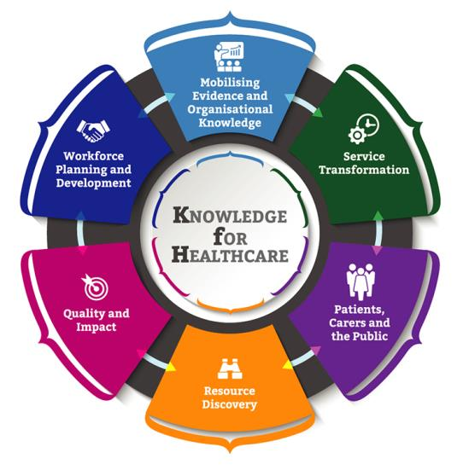
Activity Highlights
Notes:
This influence is only possible as a result of the activities that form Knowledge for Healthcare.
Workforce development
Mobilising evidence and knowledge
Quality framework
Resource discovery
Patient and public information
Service transformation
Hundreds of Library and Knowledge Services staff have been involved in work-stream, task and finish and reference groups – a combined effort.
We share highlights here of our activities as a result of Knowledge for Healthcare. With the electronic copy of the slides, you can click through to further information – including core resources.
These are the smiling faces of the participants in the second cohort of the CILIP/HEE leadership development programme, who completed their course in September 2018.
People and their skills are central to Knowledge for Healthcare, so we start this overview with Workforce Development.

Slide 12

Workforce development
Focus on employers
Greater collaboration toolkit
New health module at Manchester Met
Leadership development
National training events
Learning Zone
Greater collaboration toolkit
Embedded librarians & knowledge specialists
Development Needs Analysis re-run 2019
“It helped me to challenge myself whilst strengthening my effectiveness as a leader”
Doug Knock, LKS Manager Kings College Hospital NHS FT
https://kfh.libraryservices.nhs.uk/staff-development/
https://kfh.libraryservices.nhs.uk/for-employers/
Notes:
[Sue]
Many of the resources and opportunities created through Knowledge for Healthcare are part of the Workforce Development. This is a significant part of Knowledge for Healthcare, which is dependent on the skills and confidence of library and knowledge specialists.
Featured quote from Doug Knock who is just about to finish the senior leadership programme Full quote “Invigorating, thought-provoking and intensive, the (Senior leadership) programme has encouraged me to challenge myself and develop my leadership skill-set”
Embedded Librarians
Building evidence base for impact of clinical librarians:
Improve patient care;
Save time;
Save money.
Embedded roles for knowledge management
Advocating roles to policy makers and employers
Primary Driver: There is effective leadership, planning and development of the LKS workforce
Secondary Drivers:
Provide effective national and regional leadership
Develop an appropriately skilled, flexible library and knowledge services workforce
Enable robust workforce planning for library and knowledge services
LIS module on health is at Manchester Met

Slide 13

Leadership Programme Quotes
‘I have learned so much, it has been a brilliant experience’
Clare Quigley
Self Help UK
Notes:
Add here some further quotes from leadership programme participants from a range of health care orgs – public health, Kings fund, mental Health Trust, HEI etc

Slide 14
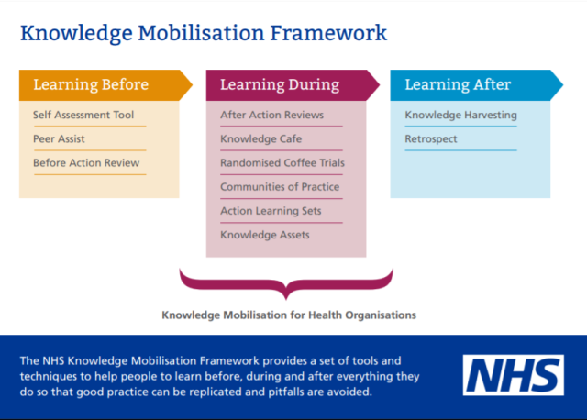
Mobilising evidence and knowledge
Knowledge Mobilisation Framework e-learning and postcards
Self-assessment tool
Strategic discussions
KM community of practice
#Knowvember
Extending services
An e-learning course in KM?
https://lists.libraryservices.nhs.uk/cgi-bin/mailman/listinfo/km
Notes:
Healthcare is a knowledge-based industry. Sharing the 'know-how' of staff, using research evidence and implementing best practice are all business critical.
Extending services e.g. NHS Ambulance Trusts, Health Education England, National Primary Care Homes, public health teams
Primary Driver:
Mobilise evidence and organisational knowledge.
Secondary drivers:
Enable healthcare systems and organisations to meet their responsibilities and objectives by Applying and use evidence in decision making, Building know-how and Continuing to learn.
Increase the confidence and capability of librarians and knowledge specialists to assess organisational needs and introduce knowledge management solutions. (Many librarians and other specialists have been managing knowledge for a significant period, but not framed their activity in these terms.)
Enable healthcare staff to use key tools and techniques to share their knowledge within their organisation.
“The library team should be our knowledge stewards in the same way as microbiology are the antibiotic stewards for the Trust.” Ben Mearns, Chief of Medicine, SASH

Slide 15
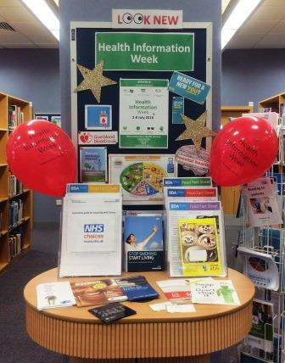
Health Literacy: Patient & Public Information
Health Information Week 1-7 July 2019
National partnerships
Health literacy awareness training
Ideas bank of resources
Senior leadership case studies to update “making the case”
https://kfh.libraryservices.nhs.uk/patient-and-public-information/
Notes:
Library and knowledge services provide support either directly or indirectly (such as evidence for patient information) to patients and members of the public. Health Information Week expanded from the West Midlands to a national campaign in 2018, in partnership with Libraries Connected and the Reading Agency. Our priority for 2019-20 is health literacy.
Partnerships – Libraries Connected MOU; Community Health and Learning Foundation re health literacy
Senior leadership project – making case
Primary driver:
To enable the public, patients and carers to use the right information to improve health and wellbeing , for self-care and shared decision-making.
Secondary drivers:
Increase the confidence and capability of healthcare library and knowledge staff to find, signpost and evaluate health and wellbeing information.
Enable healthcare staff to find and signpost trusted health and wellbeing information
Enable information providers in the public and third sectors to find and signpost trusted health and wellbeing information and share guidance on evaluating information.
Enable healthcare organisations to provide high quality information to patients and carers

Slide 16

Resource discovery
Core content re-procured 2019-22
Point-of-care tool purchased: BMJ Best Practice
Exploring national resource discovery tool
Reviewing web presence
Updating library management systems…
https://kfh.libraryservices.nhs.uk/resourcediscovery/
Notes:
In keeping with the guiding principles, streamlined procurement is essential to cost-effective and equitable resource usage across the NHS in England. We have re-procured the national core content for 2019-2020 and are seeking to increase collaborative purchasing.
Current awareness – Senior leadership project – Lucy on the group
Primary driver: Staff, learners and patients benefit from quick and easy access to relevant evidence and services at the point of need
Secondary drivers:
Procure, manage and widen access to digital resources centrally
Streamline LKS systems and delivery of library and knowledge services

Slide 17
Equitable funding model
Proposal:
Equity across the NHS in England
Ring fencing a proportion of workforce tariffs
Matched Trust funding
We still hope to have this implemented in April 2020…
Notes:
A new funding model for library and knowledge services supporting the NHS in England has been proposed. The principles of this new model include:
Equity in funding across NHS England
Recognition of the role of library and knowledge services in supporting the education and continuing professional development of NHS staff through ring-fencing a proportion of workforce tariff
Recognition of the role of library and knowledge services in supporting the clinical and management decision-making of NHS organisations through matched Trust funding.
The model has been referred to the Department of Health and Social Care for approval and will not be implemented until this has been granted. However, the principles are a useful guide to good practice in library and knowledge services funding for NHS organisations.

Slide 18
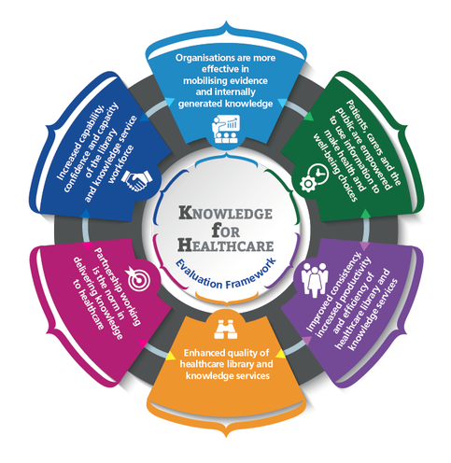
Quality and impact
Launching the new Quality Improvement Outcomes Framework
Evaluation framework for the strategy
Impact case studies
Sally Hernando innovation awards
Statistics toolkit
Working with others on research
Research gaps in health LKS
Guidance for user satisfaction research
https://kfh.libraryservices.nhs.uk/value-and-impact/
Notes:
To prove our worth, we need to be able to demonstrate the quality and impact of our activities. The Library and Knowledge Assurance Framework (LQAF) has begun to bring services to a common approach; the new quality improvement mechanism will emphasise service improvement.
User satisfaction - To support service development and quality improvement by developing guidance for LKS staff to effectively undertake user satisfaction research
Primary driver:
Enhance the quality and demonstrate the value of library and knowledge services.
Secondary drivers:
Assure the quality of healthcare library and knowledge services.
Drive the performance and improvement of healthcare library and knowledge services.
Demonstrate the value and impact of healthcare library and knowledge services.

Slide 19
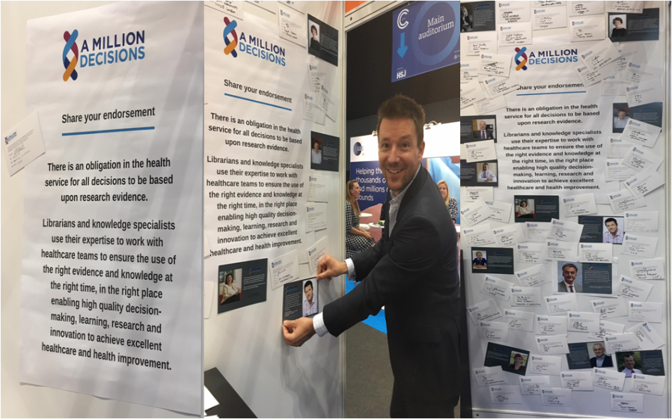


Changing Attitudes: Advocacy
Over 70 senior leaders pledge their support for #AMillionDecisions for NHS 70th Birthday
https://www.cilip.org.uk/page/AMillionDecisions
Notes:
Image NHS Confed 18 featuring Jonty Heaversedge NHSEngland endorsing the joint initiative with CILIP
Key messages of #AMillionDecisions:
The NHS/healthcare sector makes more than a million decisions every day which affect all our lives
Policymakers and service providers need to ensure that these decisions are evidence-based
Decision makers are encouraged to optimise the skills of Library & Information Professionals to meet their obligations under the Health and Social Care Act 2012.
Qualified Library, Information and Knowledge Management professionals have the skills to deliver this evidence
Campaign has:
Changed outdated perceptions
Expressed a common purpose that all librarians can get behind
Articulated to employers that the role of health librarians is business critical
Opened doors to senior decision makers
Improved our skills as advocates
Raising the profile
With CILIP Health Libraries Group this is now an ongoing initiative

Slide 20


“If you want to know the answer, ask a librarian! Library and Knowledge Services are a hidden gem in our NHS. They can play a crucial role in making sure we always make decisions based on evidence. As a CEO and and STP lead, I know they are a useful partner to help drive transformation in health and care outcomes.”
Rob Webster,
STP Lead for West Yorkshire, Chief Executive of South West Yorkshire Partnership NHS Foundation Trust
#amilliondecisions
www.hee.nhs.uk/lks
Notes:
NORTH

Slide 21

http://kfh.libraryservices.nhs.uk/value-and-impact-toolkit/kfh-impact-tools/impact-case-studies/
Notes:
NORTH Telling the story
The impact case studies have even more impact with senior stakeholders where there are numbers on time saved or cost savings.
Featured vignette from Mid Cheshire Hospitals Saving staff time and potentially reducing costs using evidence supplied by a librarian to inform policy on management of post-operative nausea and vomiting

Slide 22

Implications of The Topol Review
Effective knowledge management to support innovation and change
Networks to enable collaborative learning
Use of evidence to evaluate new technologies
Developing digital literacy of current workforce
Skills to enable patients and citizens to improve health and wellbeing through technology
Dissemination of lessons from early adoption and sharing examples of best-practice evidence-based initiatives
https://hee.nhs.uk/our-work/topol-review
Notes:
Final report from independent review by Eric Topol with recommendations relating to knowledge managers in the NHS
KEY message for LKS –
Effective knowledge management is essential to enable the spread and adoption of innovation, with lessons from early adoption shared widely (OD6): an innovation culture is dependent on a learning culture. The NHS must build a reputation as a learning organisation that values and enables the transfer of learning about successes and failures. (OD5) This can only happen with the creation of new senior knowledge management roles.

Slide 23

Knowledge for Healthcare 2020 - 2030
Update for next 5 years:
Focus on employers - advocacy
Based on evidence, growing embedded roles
Developing skills of workforce – a learning academy
Delivering recommendations from the Topol Review
We are listening
https://kfh.libraryservices.nhs.uk/
Notes:
[Sue]
Our next stage will be the refresh of Knowledge for Healthcare for the next 5 years.
Focus on employers – advocacy
Based on evidence growing embedded roles
Developing skills of workforce – a learning academy
Delivering recommendations from the Topol review

Slide 24
Effective knowledge management will be key to the creation of a learning culture to secure health and high quality care in the 21st Century and delivery of Knowledge for Healthcare has brought recognition to the role of librarians to enable this. I look forward to continuing this essential work with the enthusiasm of our healthcare librarians”
Patrick Mitchell, Senior Responsible Officer, Knowledge for Healthcare, Health Education England
Notes:
Effective knowledge management will be key to the creation of a learning culture to secure health and high quality care in the 21st Century and delivery of Knowledge for Healthcare has brought recognition to the role of librarians to enable this. I look forward to continuing this essential work with the enthusiasm of our healthcare librarians”
Contact your regional lead for further information and to get involved

Slide 25
Find out more
Effective knowledge management will be key to the creation of a learning culture to secure health and high quality care in the 21st Century and delivery of Knowledge for Healthcare has brought recognition to the role of librarians to enable this. I look forward to continuing this essential work with the enthusiasm of our healthcare librarians”
Patrick Mitchell, Senior Responsible Officer, Knowledge for Healthcare, Health Education England
North
David.Stewart@hee.nhs.uk
Midlands and East
Ruth.Carlyle@hee.nhs.uk
London and KSS
Louise.Goswami@hee.nhs.uk
South
Helen.Bingham@hee.nhs.uk
Senior Advisor
Sue.Lacey-Bryant@hee.nhs.uk
Notes:
Effective knowledge management will be key to the creation of a learning culture to secure health and high quality care in the 21st Century and delivery of Knowledge for Healthcare has brought recognition to the role of librarians to enable this. I look forward to continuing this essential work with the enthusiasm of our healthcare librarians”
Contact your regional lead for further information and to get involved

Slide 26
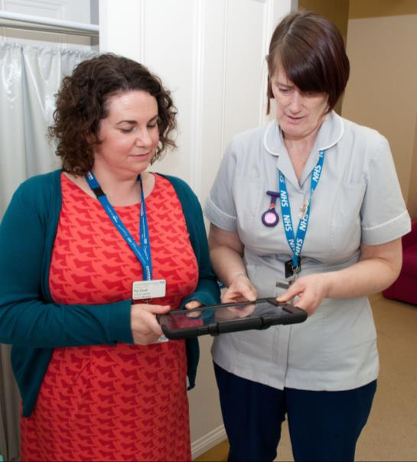
We are listening
What do you value from Knowledge for Healthcare?
What is complete
What is no longer required?
What else is needed?

Slide 27
Health Care Libraries Unit North
Employed by HEE from 1st May 2019
David and Linda based in Liverpool
Recruiting new Office Manager
Business as usual!

Slide 28
HCLU North – new address
Health Care Libraries Unit North
Health Education England
3rd Floor, 3 Piccadilly Place
Manchester M1 3BN
David.stewart@hee.nhs.uk 0774 702 1368
Gil.Young@hee.nhs.uk 0161 268 9565

Slide 29
Links to our products 1 of 2
Learning zone: https://kfh.libraryservices.nhs.uk/learning-zone/
PKSB for Health: https://kfh.libraryservices.nhs.uk/learning-zone/career-pathway-and-vocational-skills/cilip-pksb/
Greater collaboration toolkit: https://kfh.libraryservices.nhs.uk/collaboration/
Talent management toolkit: https://kfh.libraryservices.nhs.uk/tm-toolkit/
Statistics toolbox: https://kfh.libraryservices.nhs.uk/statistics-toolbox/
Value and impact toolkit: https://kfh.libraryservices.nhs.uk/value-and-impact-toolkit/
Patient and Public Information Ideas Bank https://kfh.libraryservices.nhs.uk/patient-and-public-information/ideas-bank-2/
Notes:
To send out with slides
What can you do next? Use the resources
These are examples of the products developed as a result of Knowledge for Healthcare
All are freely available to use.

Slide 30
Links to our products 2 of 2
Knowledge management toolkit: https://kfh.libraryservices.nhs.uk/knowledge-management/km-goals-tools-and-techniques/
Evidence and knowledge self-assessment tool[Board Tool] https://kfh.libraryservices.nhs.uk/knowledge-management/evidence-and-knowledge-self-assessment-tool/
Knowledge mobilisation framework e-learning and postcards https://www.e-lfh.org.uk/programmes/knowledge-mobilisation-framework/
STEP e-learning (literature searching) https://www.e-lfh.org.uk/programmes/literature-searching/
Current awareness best practice https://kfh.libraryservices.nhs.uk/current-awareness/best-practice/
Notes:
To send out with slides
These are examples of the products developed as a result of Knowledge for Healthcare
All are freely available to use.

