Slide 1
Learning, information literacy and health and wellbeing

Slide 2
Freelance trainer/consultant
Personal trainer
Coach
Deputy Chair, CILIP IL Group
CILIP fellow
CILIP mentor

Slide 3
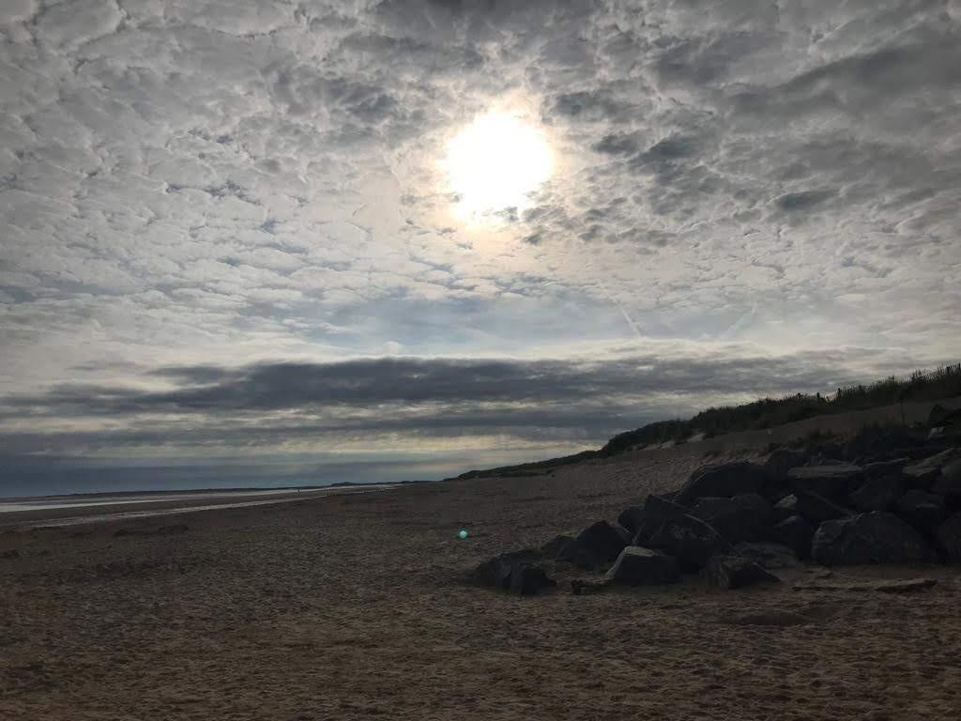
Mindfulness practice
Mindfulness practice
Notes:
Mindulfness practice:
Are you sitting comfortably? Then I’ll begin.
Back in 2017, Claire Bradshaw and I were having a day at my house preparing and designing a confidence workshop.
Claire had said she was bringing a mindfulness exercise that she wanted to try out on me so that we could see if we should include it.
That day, I was, quite frankly all over the place. I was just back from the LILAC conference so I was tired, I had a lot of other training on and had been organising for my mum to see a specialist to see if she was suffering from dementia. My ‘ping pong’ brain as I like to call it was popping off in all sorts of weird and not so wonderful tangents.
Then Claire did the exercise with me and in the space of 2 minutes I was a different person, calm, collected and ready to focus on the task at hand.
It’s the last session of the day and I’m sure you’re all brimming with ideas and could even be feeling a bit tired and struggling to concentrate. I thought that it might be useful to do the mindfulness exercise together.
Those of you who attended Claire’s mindfulness session will have already done a similar version of this exercise yesterday but that does mean that the majority of the people in this room haven’t. I hope that it will still be useful for those of you doing it for the second time.
I’m hoping that by doing this now you’ll be able to fully focus on your learning in our session.
A lot of mindfulness practices include body scanning and deep breathing exercises and this combines the two.
I’d like you make sure you are comfortable. Feel free to close your eyes if that feels right. It might help you to pay attention to my voice.
Take a couple of moments to think about how you are feeling right now. Pay attention to your thoughts and any feelings you can sense in your body.
Make sure you have both feet flat on the floor and that you’re sitting up straight but as relaxed as you can be.
Check that your breathing is regular and coming from your tummy not just your nose or mouth.
Start by bringing your attention to the soles of your feet. Become aware of the sensations you can feel in the bottom of your feet. Feel the surface of your heels, toes, arches and the balls of your feet and how they feel as they’re in contact with the soles of your shoes.
Begin to expand your awareness from your feet up through your lower legs and calf muscles, to your knees, thighs, pelvis and hips. Think about how you can feel your thighs in contact with your chair.
Become aware of your centre. Put your hand on your tummy if that helps. Breathe deeply into your core and say to yourself. “I am here”, “I am present” “I am centred”
Continue from your tummy and expand your awareness up your spine, into your lungs, rib cage and chest. Bring awareness to your heart centre in your upper chest and breathe into your chest. Say to yourself “I am open”
“I’m opening”
Continue expanding your awareness up through your shoulders, upper arms, elbows, lower arms, wrists, hands and fingers. Expand this awareness through your neck, throat and face. Be aware of your senses, your eyes, ears, nose, mouth and tongue. Bring your awareness to your brain and to your skull. Breathe as if you were breathing into your head centre, bringing oxygen and energy to them.
Say to yourself “I am awake, I am aware, I am alert and clear.
Staying in contact with the physical sensations in your body starting with your feet and moving up to your tummy, heart and head, become aware of the space around you. Be aware of the room and the other people in it. Be aware of the connections you share and the vast array of resources available to you. Take a last deep breath and say to yourself “I am connected”
Now take a couple of moments to see how you feel now?
Has anything changed?
I’m hoping that you now feel prepared and able to focus on our session.

Slide 4
CILIP Definition of Information Literacy 2018
“Information literacy is the ability to think critically and make balanced judgements about any information we find and use. It empowers us as citizens to develop informed views and to engage fully with society.”
Notes:
Let me begin with reminding you of the top level statement from the definition.
“Information literacy is the ability to think critically and make balanced judgements about any information we find and use. It empowers us as citizens to develop informed views and to engage fully with society.”
Underneath this broad and encapsulating statement we have 5 different contexts or lenses which enable us to illustrate the breadth of what we talking about when we say information literacy.

Slide 5
Information Literacy and Everyday Life
Checking information online
Online transactions
Behave ethically online
Social media
Digital footprint
Privacy
Notes:
Our first lens is that of every day life information literacy.
Vital to everyone as the world seemingly, revolves around all things online.
Government website, shopping, holidays, teaching our children to be safe online, all part of our everyday lives.

Slide 6
Information Literacy and Citizenship
How to understand the world around us?
Recognise bias and misinformation
Fake news
Critical judgement
Notes:
In our second lens we look at the importance of IL skills when negotiating the murky waters of misinformation and fake news
We want people to be able to make more informed choices in elections and referendums.

Slide 7
Information Literacy and Education
All stages of education
School, Further Education and Higher Education
Critical thinking skills
Transition from school to Higher Education
Equips learners with intellectual strategies
Notes:
The next 3 contexts particularly impact the work you do as health and medical librarians.
Education probably seems a logical space for IL but realistically, higher education has the monopoly on IL educations and work, but even so, as you know, students struggle to link skills learnt from one assignment to the next.
School and further education librarians struggle to show how necessary IL is to their pupils’ lives and education because it hardly features in the national curricula of England and Wales.
Our schools rep Sarah Pavey is currently doing a tremendous job analysing the different curricula and her findings go someway to explaining why students find the transition to HE so hard,
She’s also incredibly excited about the Scottish Advanced Highers curriculum. Apparently it’s wonderful. As far as she can tell, they’ve been advised by a librarian.

Slide 8
Information Literacy and the Workplace
Knowing when and how to use information
To help achieve organizational aims and adds value
Interpret work related information
Contributes to employability
Teamworking
Problem solving and analytical skills
Notes:
As well as training medical, nursing and allied heath professionals to become evidence based practitioners in a subject area that’s vast and constantly evolving, you also train students, adding to their graduate attributes and employability.

Slide 9
Information Literacy and Health
Using credible and reputable healthcare sources when looking for treatment and prognosis.
Becoming active partners in healthcare
Engaging in informed dialogue with healthcare professionals.
Making it easier (NHS Scotland)
Working with HLG and Health Education England on campaigns such as “A million decisions” and the Health Literacy Toolkit
Notes:
Finally the definition looks at health literacy, I won’t be going into great depth here. after all you’re health and medical librarians and I’m not.
So in terms of this new definition we discuss how having health literacy skills help people to make informed choices relating to the health and wellbeing of individuals and their families and become active partners in their healthcare.

Slide 10
Mainstreaming IL
Notes:
What do I mean when I say that we are working to mainstream IL?
Well essentially our aspiration is that people leave school, not just with the 3 Rs but with information literacy skills too.
So the 3Rs and an I
Now we might not end up talking about IL – the phrase itself, but we want people to leave school able to think critically and make balanced judgements about any information they find and use.
Nick Poole, Yvonne Morris, Stephane Goldstein Sarah Pavey and I met to discuss the future of IL and had a discussion about why IL needs to be mainstreamed:
To avoid negative outcomes at a global scale and maximise the positive outcomes
To restore public faith in democracy
To restore trust in expertise
To avoid social and economic inequality
Because there’s need for a factual rather than an emotional response
At the meeting we talked about what who our audiences were and thought about where we should be embedding IL or at least having conversations about IL :
We discussed
Embedding IL further into the PKSB
Library schools (via accreditation)
Public librarians (via the Public Library Skills Strategy)
School librarians
When we spoke about external stakeholders we talked about:
The education space in the broadest sense (formal, informal, lifelong learning, adult, HE/FE)
Teachers; managers; governors
Chartered College of Teaching
Ofsted
Personal, Social, Health and Economic (PSHE) Education Association
Unions
Government (departments such as DCMS/DfE)
We talked about some of the ways we possibly could access these internal and external stakeholders
Look for external funding to train school librarians to deliver information literacy and evaluate impact.
Seek to build IL awareness into QTS training.
Raise profile of IL through the CILIP conference programme and Information Professional Magazine.
Ensure IL is covered in the CILIP/SLG response to the OFSTED consultation.
We want to engage with other CILIP Special Interest Groups. So that we can see where if any crossovers may lie and seek to collaborate with them

Slide 11
Information Literacy
Information literacy abilities are compromised when people are:
Unwell, stressed or trying to find information quickly
This affects all parts of the process: finding, evaluating, analysing and processing information
When we’re talking specifically about health literacy, people are ill, stressed AND trying to find information quickly. In these circumstances, finding the correct information to manage their condition really can actually be a life or death matter.
What can we do?

Slide 12
The Slow Movement
“There is more to life than increasing its speed”. “It is a cultural revolution against the notion that faster is always better. The Slow philosophy is not about doing everything at a snail’s pace. It’s about seeking to do everything at the right speed. Savouring the hours and minutes rather than just counting them. Doing everything as well as possible, instead of as fast as possible. It’s about quality over quantity in everything from work to food to parenting”.
Gandhi
Carl Honoré
Notes:
Photo by Sebastian Molinares on Unsplash
The slow movement originally came about in the 1980s with a protest against fast food. Carlo Petrini's protest against the opening of a McDonald's restaurant in Piazza di Spagna, Rome in 1986 that sparked the creation of the slow food movement. Over time, this has developed into a movement and incorporates other slow subject areas, such as slow ageing, slow cinema, slow counselling, slow education, and even slow fashion
Carl Honoré: Canadian journalist. The slow movement is trying to encourage a world of reflection rather than reaction. Honoré wants us make sure that we are doing things as well as we can as opposed to as quickly as possible. Tip: Stop what you are doing and ask yourself if you are doing this well and if not would it be improved by doing it slower. If the answer is yes – take 5 deep breaths and then start doing it more slowly.
Our obsession with going fast and saving time leads to rage. Road rage, air rage, shopping rage, office rage. Age of rage. Of not thinking about our humanity.
Acceleration and speed have been growing since the industrial revolution. He thinks that we’re all worshipping at the alter of growth and consumerism. He believes this is why we have got to this point with Trump being elected and the rise of the extreme right.
We want to save time and do more. But it can also be a form of avoidance. Where we don’t have time to reflect on ourselves and the big questions of the day. We don’t have to be alone with our thoughts and we don’t use our time to reflect on whether politicians really are looking out for us.

Slide 13
Mindfulness
Mindfulness is the basic human ability to be fully present, aware of where we are and what we’re doing, and not overly reactive or overwhelmed by what’s going on around us.
www.mindful.org/what-is-mindfulness/

Slide 14
The Psychological Effects of “Fake News”
Those who aren’t very good at making judgements about information they read or see in newspapers, TV or social media, especially misinformation such as fake news, experience a negative physical response to it. This means that misinformation is actually bad for their physical health.
On the other hand those people that are very good at making judgements about information tend to have a much healthier physical response when they encounter misinformation.
Given the constant barrage of fake news that we come across everyday of our lives it clearly shows there is a worrying public health issue emerging.” Dr. Geoff Walton, Manchester Metropolitan University

Slide 15
Contemplative Practices in Libraries
“Information shapes the way people can be and act in the world”. …
Gorichanaz sees the “link between information studies and contemplative studies to propose six contemplative aims for information: being, attention, meaning, compassion, unity, and wisdom. … Being is one’s existence as subject, a sense of presence and history; attention is awareness, observation and presence; meaning is what contributes to one’s being a person, making their life feel valuable; compassion is the recognition of and reaction to unsatisfactoriness in the world; unity is a sense of oneness; and wisdom is the unity of thought, emotion and action.”
Tim Gorichanaz (p. 27)

Slide 16
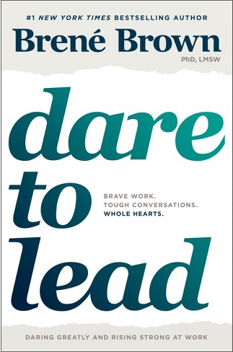
Brené Brown on Learning
“Easy learning doesn’t build strong skills”.
Brené Brown, Dare to Lead p.170
Not all learning has to be hard but learning SHOULD challenge us.
This is similar to Vygotsky's Zone of Proximal Development - things we can do unaided, things we can’t do (ZPD in between).
Notes:
Citing Mary Slaughter and David Rock NeuroLeadership Institute - organisations try to design learning to be easy and fun - unfortunately this is not really promoting deep learning. We are risking designing for popularity. They call it desirable difficulty

Slide 17
Learned Optimism: Martin Seligman (2006)
Adversity – these are everyday setbacks you experience when teaching
Belief – how you interpret the adversity – what you say to yourself
Consequence – the feelings you experience as a result of B (your belief)
Disputation – return to B and try and take a more objective view
Energisation – accept the disputation and negative feelings will be reduced and you’ll have energy to continue teaching and feel positive
Notes:
Martin Seligman (2006)’s model of how you respond to adversity. Based on two ideas:
Feelings are powerful and can help or hinder recover
Feelings are preceded by thought – so how you interpret them is key. Listen to your internal dialogue, dispute the negative!

Slide 18
My experience of exercise and personal training
Stress
Depression
High Blood Pressure
Type 2 Diabetes
Dementia
Angina
Coronary Heart Disease
Heart Attack
Stroke
Lower levels of bad cholesterol
Higher levels of good cholesterol
Mindfulness
Notes:
I started going to the gym in November 2016. Prior to this the only exercise I’d been doing was Pilates and a bit of swimming
I started after a coaching session with Claire, and it was something that I could do, for me, to see if it could help me cope more effectively with my mum’s memory problems. She’s was diagnosed with Alzheimer’s a few months ago and as you can imagine it’s been a pretty stressful and anxious few years.
One of the things I have noticed, because I was stressed a lot more often, is that stress leads to more stress. I was stressed and anxious about mum and I noticed that I was starting to get anxious and really nervous before any workshops I was getting.
I also noticed that when I’m stressed and I’m sure you’ll have noticed this too, I tend to catastrophise or overreact. ‘We’re all going to hell in a handbasket’ was becoming a constant refrain. And I realised I wasn’t always as rational as I could be. Especially when reading the news or social media.
So for the months before I started exercising at the gym, it was really pretty horrible.
The thing that surprised me most was that I really enjoyed it. My gym focuses on semi-personal training and they use a coaching approach (as in mine and Claire’s type of coaching) which I find works for me.
After few weeks I also discovered that Endorphins weren’t the urban myth I’d always assumed them to be.
I noticed that it really helped to stabilize my mood and that I felt more confident. After years of assuming exercise wasn’t for me, this was pretty powerful.
And talking about power. There is something wonderful about lifting weights. That taps into my psyche. And banishes years at school of being picked last. Being able to lift heavy things makes you feel strong.
The first day I did a deadlift with a barbell, I was really proud of myself.
Knowing that I’m pretty strong has increased my confidence and can do attitude. I really will try almost anything now. I did a 3 hour long hand stand course this year, which I wouldn’t have dreamed of 2 and half years ago.
I was fascinated that exercise was having a effect on my confidence and my mental health and even my confidence with my work. So I started to research and have conversations with the trainers at the gym about how exercise can impact lots of different aspects of your life. I started to see links and parallels between the soft skills training and coaching AND exercise.
I started looking at things from a holistic viewpoint because really, when do human beings ever do any task or activity in isolation
This holistic perspective made me want to learn more and see if there was a way I could link my coaching and training work with exercise so that I could look at the whole person not just separate parts of them.
This is when I decided to train as a personal trainer – I qualified in March.
Things that I learnt from my Level 2 and 3 personal training courses were that exercise can
Help alleviate stress and can help some people with their symptoms of depression.
It helps reduce
High Blood Pressure
It is one of the major ways you can lower you blood glucose levels, it has a bigger impact that taking medication.
Type 2 Diabetes
Interestingly I’ve just been on a diabetes course with mum – stress and lack of sleep as well as food choices, exercise and taking meds all have an impact on type 2 diabetes)
Exercise also reduces your risk of suffering from
Dementia
Angina
Coronary Heart Disease
Heart Attack
Stroke
It also lower levels of bad cholesterol and increased your levels of good cholesterol
And for me, it also a way that I can be more mindful. I’m present and in the moment because I’m concentrating on what I’m doing and I’m breathing.
So it can do all of these things AND you will often be more receptive and open minded after exercising because you’ve been mindful for an hour.
If we think about how mental health professionals are prescribing mindfulness as something that can aid many different conditions and that when we’re suffering from anxiety we lose our perspective and rationality
Anxiety – judgement, rationality
Confidence – feeling strong as opposed to feeling powerless – (against the scaremongering of fake news)
Story about one day having an awful day with mum and being really upset about it and going to the gym. When I’m stressed and upset I can’t lift as heavy weights. As much as our mind can be affected by what we do with our bodies, so our bodies are affected by our minds.
Link Pilates and going to the gym with mindfulness

Slide 19
Final Thoughts and Conclusions
Finding information can be a source of stress, particularly when it relates to finding health information about ourselves or a loved one
There are benefits from slowing down, exploring meditation and contemplative practices
There are benefits from viewing IL and learning more as mentoring and coaching
Librarians play a vital role
Notes:
information literacy and health literacy are linked in a quite complex way that we (the ILG) are only starting to explore and understand
that finding information can be a source of stress, particularly when it relates to finding health information about ourselves or a loved one, but fake news is particularly toxic here
There are benefits from slowing down, exploring meditation and contemplative practices
There are benefits from viewing IL and learning more as mentoring and coaching
Basically health librarians play a really important role here (and that is our key summing up point?) and we'd like them to come talk to us, use their systematic review skills etc.

Slide 20
Any Questions? https://infolit.org.uk/ @infolitgroup #ILDefinition

Slide 22
References and Further Reading
Brown, B (2019) Dare to Lead. Vermillion: London.
CILIP (2018) CILIP Definition of Information Literacy. Available at: https://infolit.org.uk/ILdefinitionCILIP2018.pdf
Gorichanaz, T & Latham, K.F. (2019) Contemplative aims for information. Forthcoming in Information Research. Pre print available at: http://timgorichanaz.com/pdf/aims.pdf
Hara, Billie (2010) Reflexive Pedagogy. The Chronicle of Higher Education. Available at: https://www.chronicle.com/blogs/profhacker/reflexive-pedagogy/22939
Honoré, C. (2004) In praise of slow: how a worldwide movement is challenging the world of speed. Orion: London.
Honoré, C. (2005). In praise of slowness. (TED Talk) [video] Available at: https://youtu.be/UhXiHJ8vfuk [Accessed 4 Jun. 2019].
Seligman, M. (2006) Learned Optimism. Vintage Books: USA
Walton, G., Pickard, A. & Dodd, L. (2018). Information discernment, mis-information and pro-active scepticism, Journal of Librarianship & Information Science, 50 (3), pp.296-309 http://journals.sagepub.com/doi/abs/10.1177/0961000618769980

