Slide 1
Virtual Christmas Study Morning 2020
#YOHHLNet

Slide 2
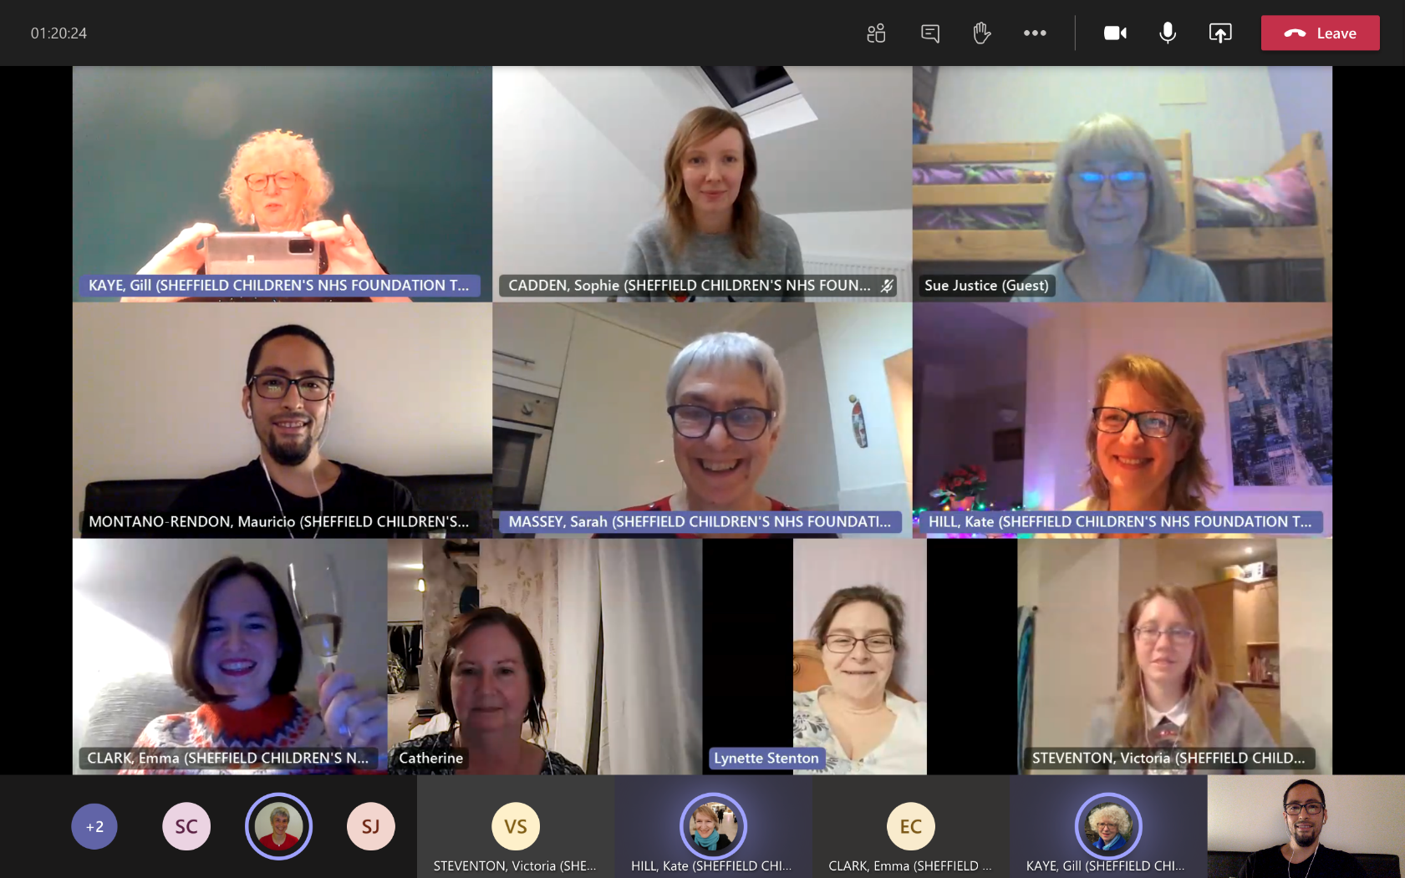
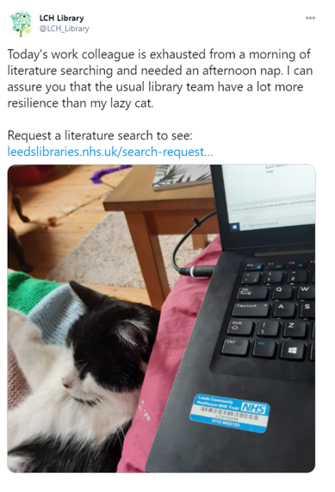
Adjusting to new ways of working (and new colleagues) for LKS staff from Leeds Community Health Library (LCH)
Delivering services virtually, such as Shefield Children’s Hospital Illingworth Library’s Reading Group. SCH staff, Uni staff and former SCH staff have met virtually every month since March, they have described the virtual group as being a ‘lifeline’ and ‘a spark of joy’.

Slide 3
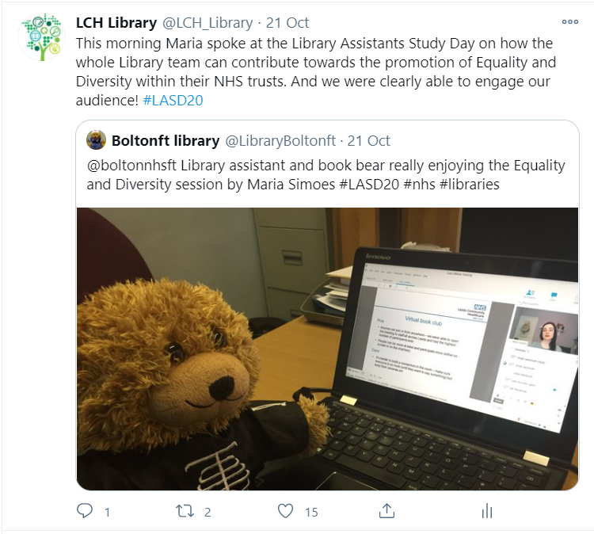
Maria from LCH speaking at the Library Assistants Study Day, via Webex, about the special edition of their book club dedicated to Why I’m No Longer Talking to White People About Race.
Staff organised this following their trust’s call for initiatives in response to the disproportionate impact of COVID-19 on BAME communities, and the resurgence of the Black Lives Matter movement.

Slide 4
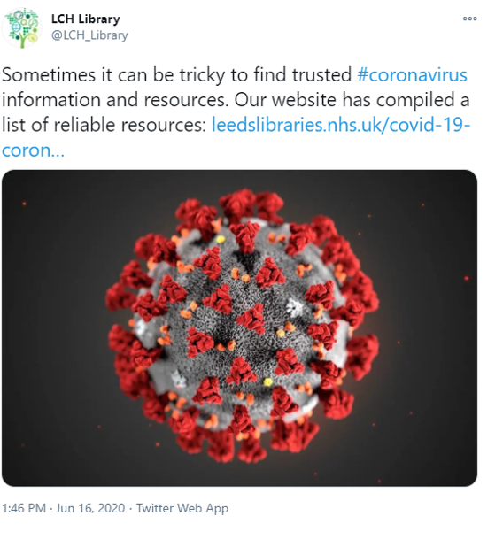
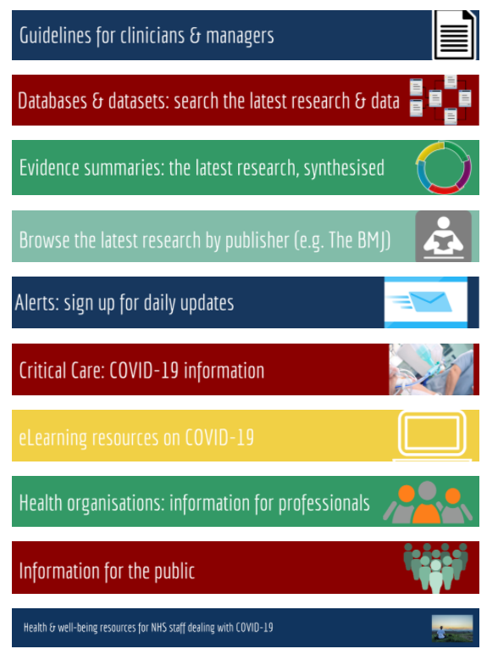
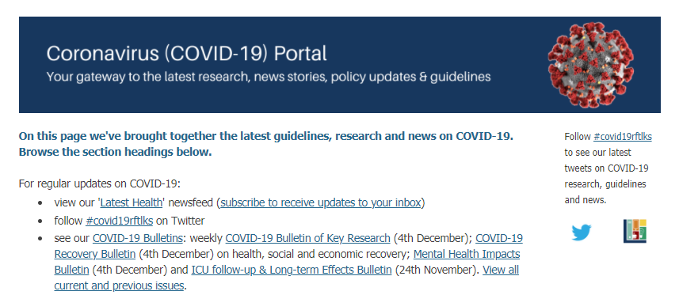
Signposting resources and a purpose-built portal at Rotherham Hospital’s Library & Knowledge Service
Directing users to evidence-based
information at LCH

Slide 5
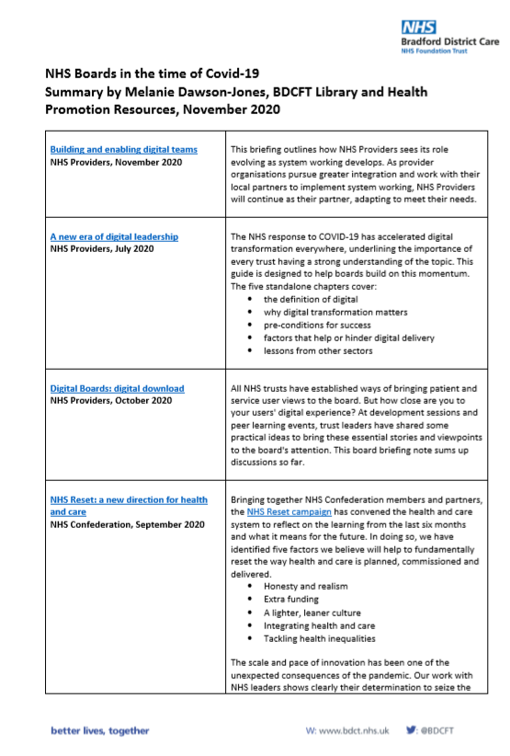
Evidence summaries as requested by the Board at Bradford District Care.
The summary explores system working and partnerships – potential future NHS policy; culture on leadership; delivering the best high quality safe care; delivering the best high quality safe care in response to the pandemic.

Slide 6
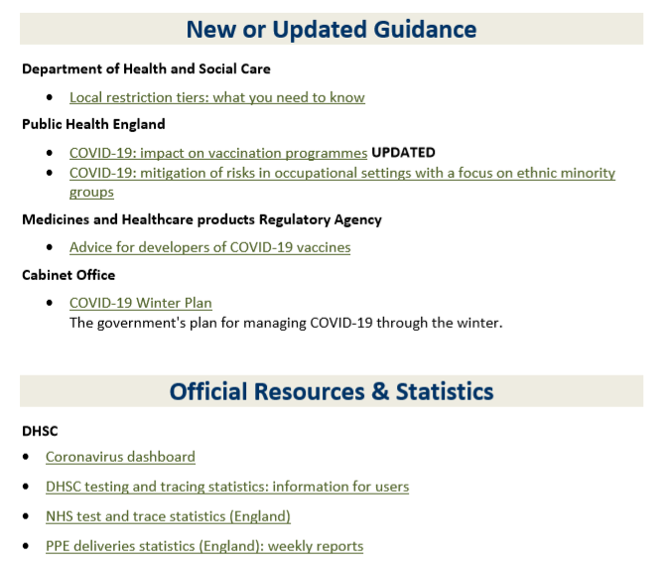
LKS staff at the NHS Staff Library and Information Service at Mid Yorkshire Hospitals are producing weekly evidence bulletins originally requested by the Trust’s Head of Medical Education to be sent to medical directors. The library team has also widened the brief to include nursing and AHP staff.

Slide 7
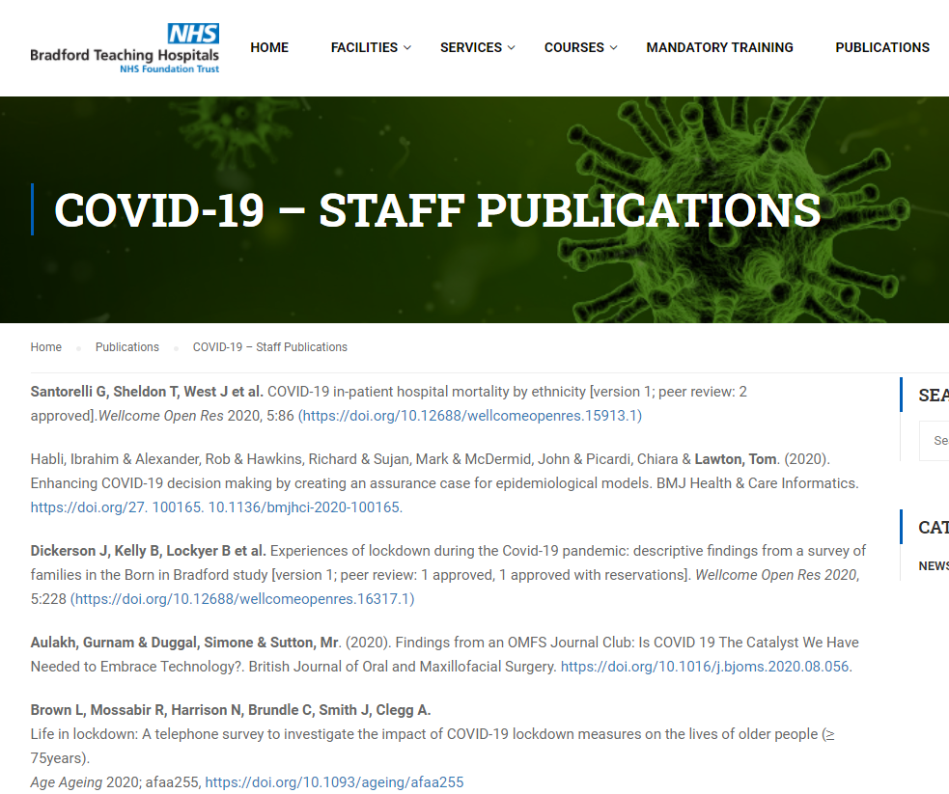
Library staff at Bradford Teaching Hospitals have developed a repository of their staff’s publications around Covid-19.
This involved contacting researchers, collating all the papers; and even doing some programming to create this dedicated collection.

Slide 8
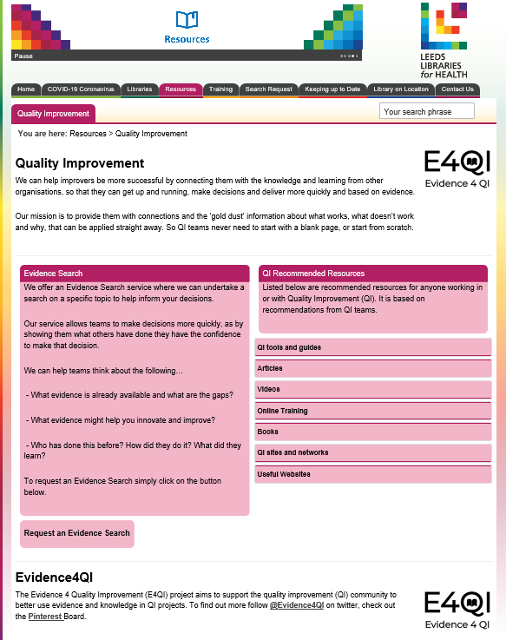
Staff in the Library and Research Centre at Leeds Teaching Hospitals have been working with their Quality Improvement teams as part of the Evidence 4 QI (E4QI) project. This has been a real highlight for staff this year, and as well as developing their relationships with QI professionals, they have also produced a webpage explaining how they can support QI projects. This has been promoted through their QI networks; and support from the library service is now also highlighted in QI training.
Further information is available on their website:
https://www.leedslibraries.nhs.uk/resources/quality-improvement/

Slide 9
Welcome & Introduction
- David Stewart
#YOHHLNet

Slide 10
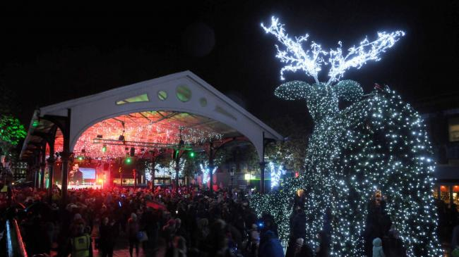
Seasonal Reflections
David Stewart
Head of NHS Library and Knowledge Services North
Notes:
Christmas in Warrington

Slide 11
Notes:
Nightingales
Alerts
Web pages
Redeployments
Amazing flexibility of all staff in very challenging times

Slide 12
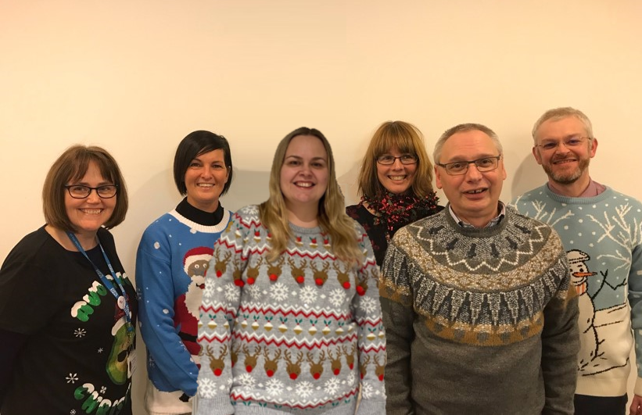
The Team

Slide 13
Knowledge for Healthcare
2021 - 2026
Notes:
Due for publication 2nd or 3rd week of January 2021

Slide 14
Notes:
Value proposition
Space
Psychological support for embedded librarians
Thinking about your quality and improvement outcomes framework (new dates announced?)

Slide 17
What have we learned?
- Claire Bradshaw
#YOHHLNet

Slide 18
YOHHLNet
Christmas Study Day
Claire Bradshaw
Notes:
Short mindfulness activity to settle in
Context – a tough year! Capture learning in a fun way!
You’ll all have brought with you an object….
Talk about difference between rumination and reflection

Slide 19
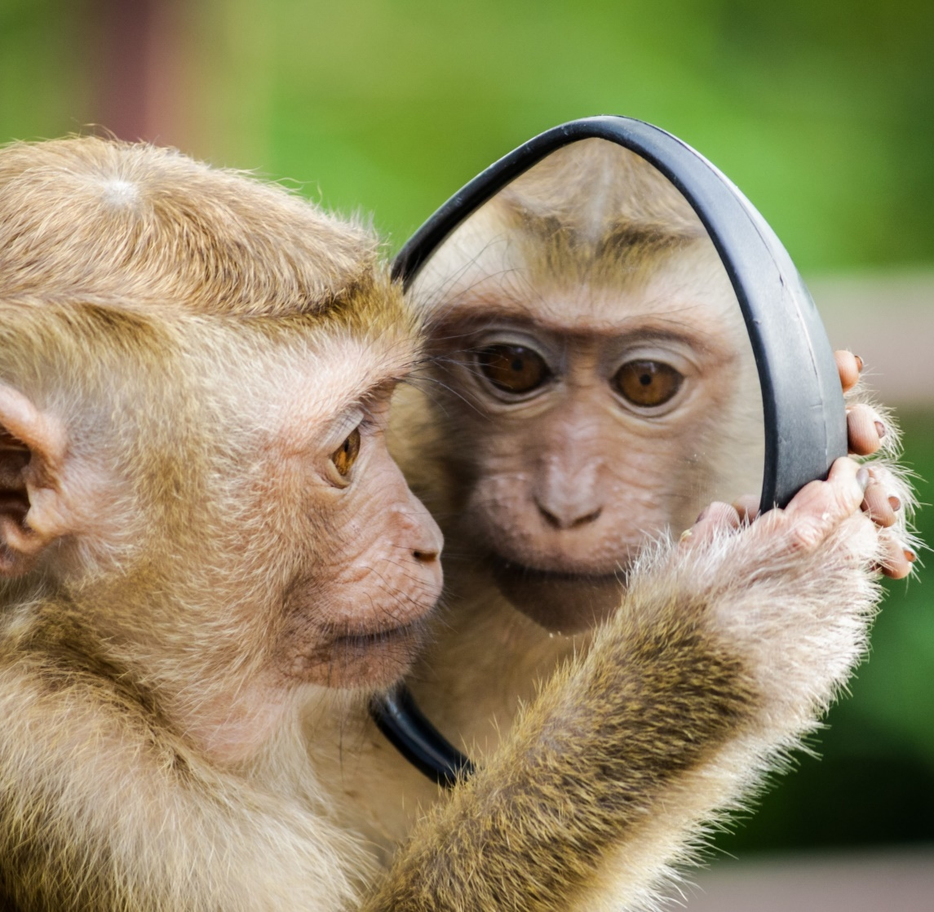
Rumination
Reflection
VERSUS

Slide 20
A reflective model
Description and self-awareness
What happened? What did I do? What did the other person do? What was I trying to achieve? What was good or bad about the experience?
What?
So what?
Now what?
Analysis and evaluation
What is the importance of this? What more do I need to know about this? What have I learned about this?
Consider actions, options and next steps
What could I do differently? What do I need to do? What might be the consequences of this?

Slide 21
Activity
Identify a timekeeper
Identify a ‘scribe’
Each person to share how your object encapsulates your learning from 2020 (No more than 2 minutes each!)
Work together to create:
A carol
A poem
A story
A Christmas card
(11 minutes) – be prepared to share!

Slide 22
Thank you!
Get in touch:
www.clairembradshaw.co.uk
claire@clairembradshaw.co.uk

Slide 23
BREAK
Please return by 11:15
#YOHHLNet

Slide 24
Escape Room:
Beat the Hacker
#YOHHLNet

Slide 25
BREAK
Please return by 12:30
#YOHHLNet

Slide 26
YOHHLNet Awards
Library Superstar 2020 Awards
Head of Library & Knowledge Services North Award
#YOHHLNet

Slide 27
Closing Remarks
- Heather Steele
#YOHHLNet

Slide 28
Thank you for attending our Virtual Study Morning
#YOHHLNet

