Slide 1
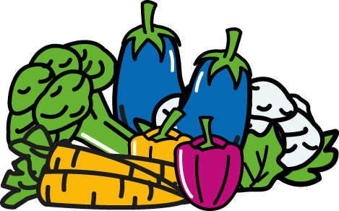
Christmas Lessons 2020:
how we’re surviving!

