Slide 1
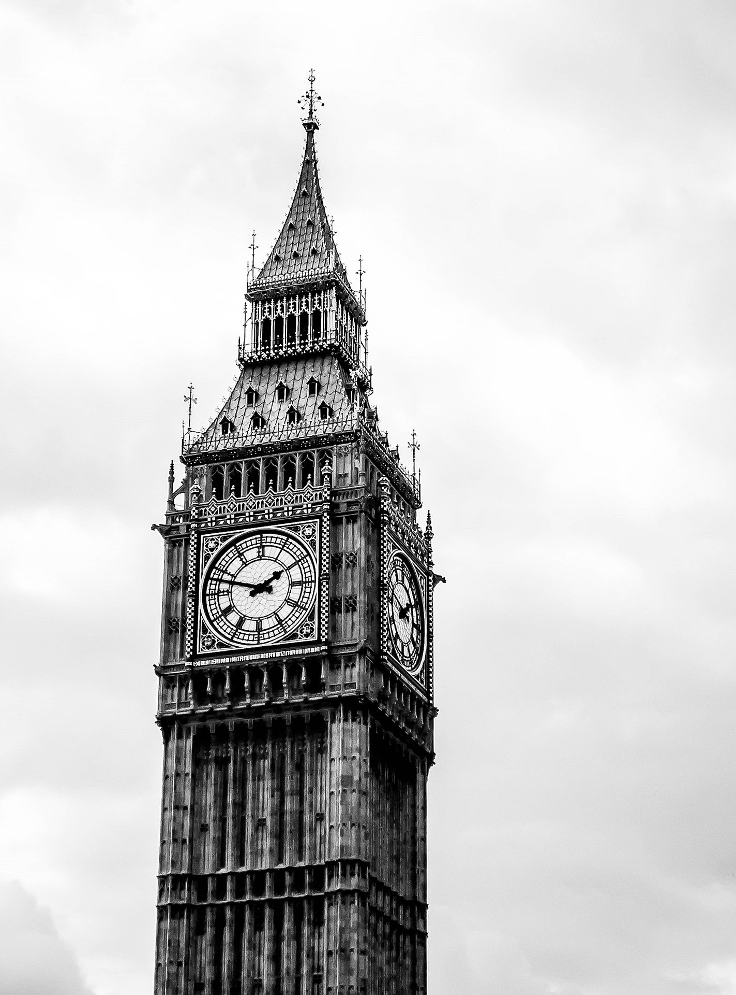
Copyright News
Copyright Countdown to Brexit
Orphan works exception will no longer apply to UK-based institutions
Agreement to sign up to The Marrakesh Treaty will not be in place. This governs improved access to accessible content
https://www.wipo.int/marrakesh_treaty/en/
Portability Regulation will cease to apply to UK-EEA travel from 1 January 2021
https://www.gov.uk/guidance/changes-to-copyright-law-after-the-transition-period

Slide 2
Copyright News
Impact of Covid on Information Access
High price of e-book licences
The inability to licence specific items Limits to the CLA scheme
The failure of publishers to maintain generous offers
Analysis of survey has no yet been completed
Please record any case study or issue you have in relation to copyright.
These case studies change practice and drive changes to legislation.

Slide 3
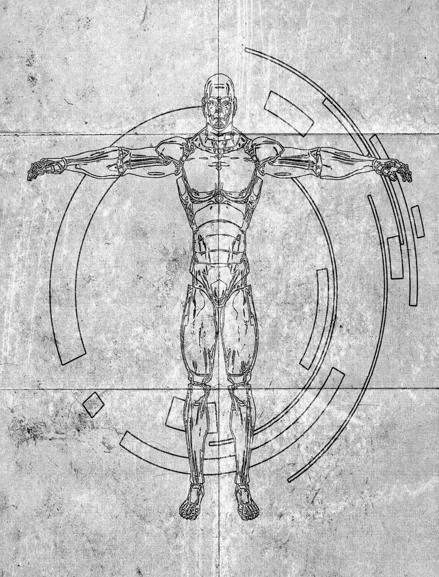
Copyright News
AI & IP Consultation
Argues that AI copyright needs to be in the copyright framework not licencing agreement
In support of an exception which permits the analysis of ‘anything recorded in the work’ and notes that some elements may be covered by data mining exceptions
Copyright should work to protect and encourage human creativity and should not be used to protect the creations of machines.

Slide 4
Royalties Review - Breakdown by type of Data Collected 2020
Excerpts from CLA Presentations 28th Oct 2020
Total Raw Data Received:
42,645
Serials
1) Journal articles received from other libraries (ILL) - 8,385
2) Journals own stock articles copied internally for own users - 2,000
5) Print Journals held in own library stock – 1,122
8) E-journals or magazines available in own library – 145
9) Top Title Journals - 98
3) ILL-Book loans for own users from other libraries – 1,430
4) Book loans - from own stock - 20,237
6) Reference Books-books with loan status of reference only – 1,065
7) E-books available in own library - 8,071
Books
Websites
10) Top Websites - 92
South – 4 returns
North – 4 returns plus North tab 1 for PANDDA organisations
Midlands and the East of England – 2 returns with no more returns expected
London, Kent, Surrey and Sussex – 3 returns

Slide 5
Data Quality Feedback from 2019
Good
High quality data: In 2019, a large proportion of the data was provided with an ISSN/ISBN or Title and Publisher information
Majority of good data: Vast amount was of good quality and so we were able to process this
Development Areas
Improvements for 2020
Template amendments: Below Data Types added to capture additional data supplied:
7) E-books available in own library
8) E-journals or magazines
Incorrect ISN: Should be 8 ISSN and 10/13 ISBN
Invalid ISN: If no Title information is provided, we cannot research these any further.
Multiple ISNs: Ensure only 1 ISN is provided per line of data
CLA to feedback at the end of the 2020 exercise.

Slide 6
NHS in England – Licence Plus Data Analysis

Slide 7
NHS in England – Licence Plus Data Analysis
The Regions - Additional Units – April - September 2020 – Top 10 Titles
Ranking | Units Ordered | Title
1 | 11 | INTERNATIONAL JOURNAL OF GYNECOLOGIC CANCER
1 | 11 | JAMA
1 | 11 | AMERICAN JOURNAL OF PERINATOLOGY
1 | 11 | AMERICAN JOURNAL OF OBSTETRICS AND GYNECOLOGY
5 | 10 | SURGICAL LAPAROSCOPY, ENDOSCOPY & PERCUTANEOUS TECHNIQUES
5 | 10 | CARBOHYDRATE-BASED VACCINES: FROM CONCEPT TO CLINIC
7 | 9 | SURGICAL ENDOSCOPY
7 | 9 | TELEMEDICINE AND E-HEALTH
7 | 9 | JOURNAL OF CRANIOFACIAL SURGERY
7 | 9 | AMERICAN JOURNAL OF HEALTH-SYSTEM PHARMACY

Slide 8
Licence Plus Document Delivery
https://www.cla-nhscontent.com/

Slide 9
Current usage in England
112 Trusts in England are currently using the tool, plus PHE and NICE
Notes:
112 trusts in England are now using the NHS tool. 70 of the 112 are completely new to the tool and 42 previously ordered from the British Library and the remaining 17 users of Licence Plus have not yet used the new tool.

Slide 10
Copyright News
First Responders
Copyright First Responders Needs You!!!!
Volunteer required to support queries from the North of England
Opportunity to work alongside Copyright Licensing Agency to improve access to information
Full support given to help build your knowledge of copyright issues
Interested contact: Susan.smith2@mcht.nhs.uk
01270 273172

